Slide 1
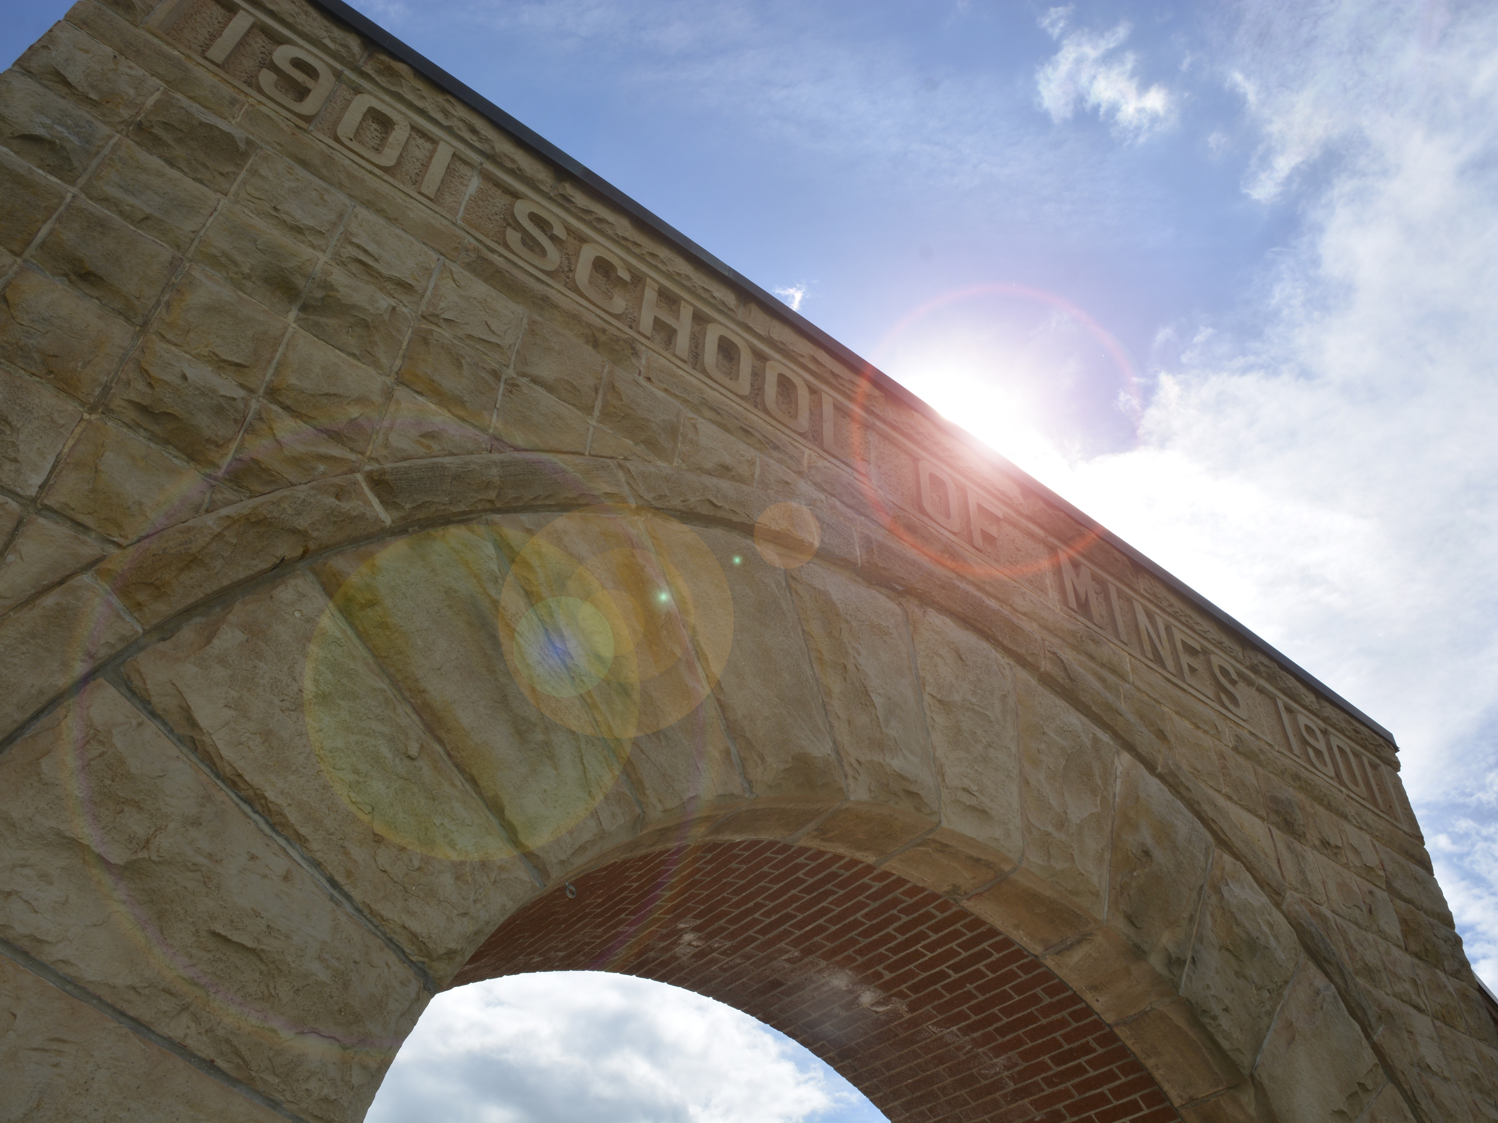
SD Mines Apparel Licensing
Ordering Apparel for
Campus Groups & Departments

Slide 2
SD Mines Licensing Policy
The University marks are registered with the United States Patent and Trademark Office. Licensing for reproduction of all University marks and verbiage on merchandise for resale to faculty, staff, students, and the general public must be approved by the University Bookstore Director or designee.
Approval may not be given for items:
of poor quality;
that are not representative of the institution’s mission;
whose resale does not benefit the institution or a University-recognized entity financially
Resalable items
Licensing forms required via Bookstore Director
Non-resalable items
Authorized by Vice President of University and Public Relations

Slide 3
Become Licensed & Current Vendors
How to Become Licensed
Complete University’s Non-Exclusive Licensing Agreement
Marlin, Bookstore Director
Cost
Initial fee = $100
Annual renewal = $50
Art approvals required
Royalty rate is 10% of net price of goods
Depending upon the vendor, licensing time frame can vary
Fall 2017 Local Vendors
Stec’s Advertising Specialties
JJ’s Engraving
Dakota Sports
The Rocker Shop
No online vendors are licensed at this time
Custom Ink
Vistaprint
Etc.

Slide 4
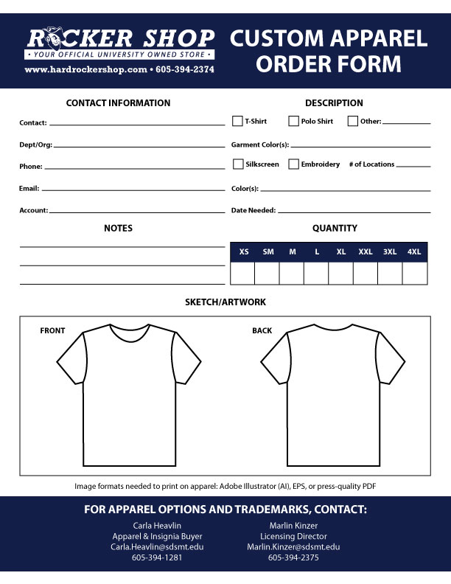
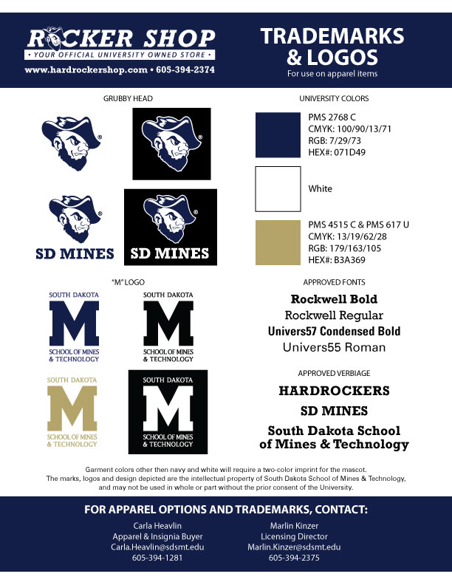
Custom Shirt Order Form
www.hardrockershop.com
Left hand side, select “Resources”
Click “Custom Shirt Orders”
Fill out via Adobe or print
Submit to The Rocker Shop
Email:
Carla Heavlin
Marlin Kinzer

Slide 5
Approved SD Mines Logos & Verbiage
Trademarks
Licensed marks = federal trademarks
Cannot be reproduced UNLESS licensed to do so
Verbiage
“HARDROCKERS”
“SD MINES”
“SOUTH DAKOTA MINES”
“SOUTH DAKOTA SCHOOL OF MINES & TECHNOLOGY
NO “AND” - MUST BE “&”
UR, Rocker Shop, and approved vendors can help with artwork/graphics

Slide 6
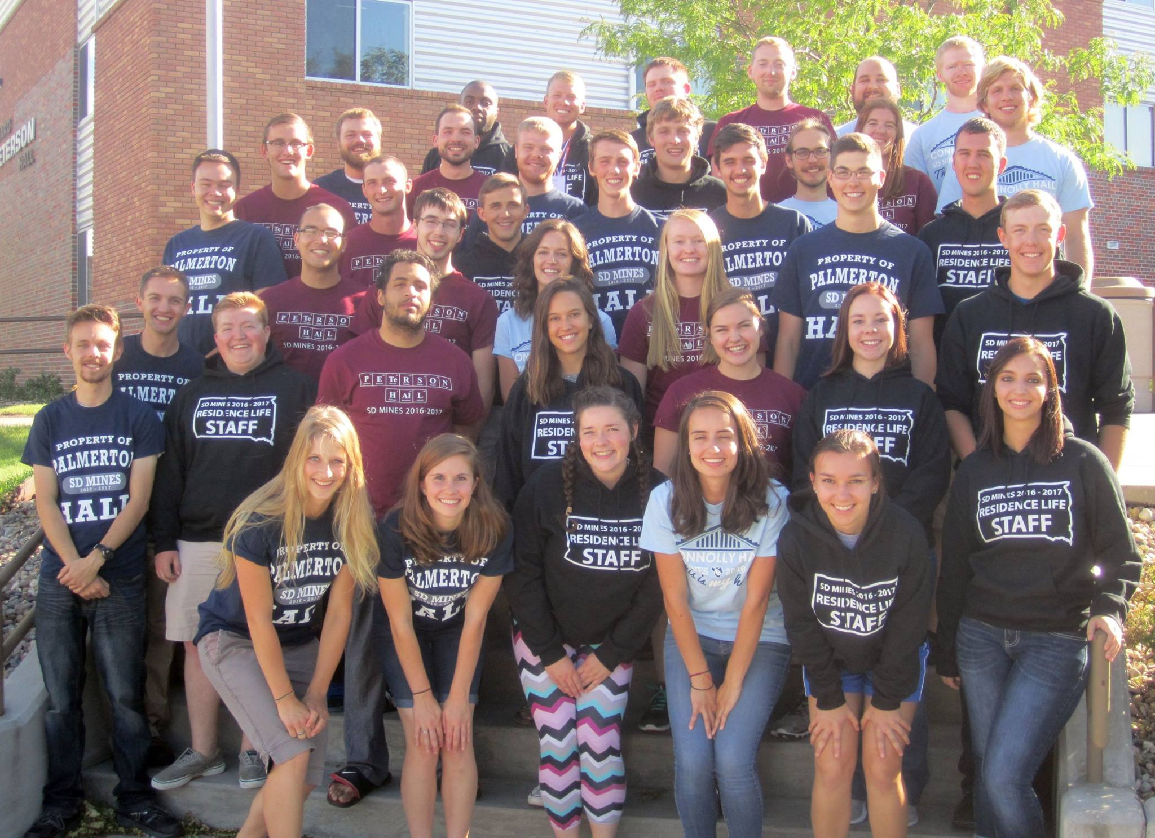
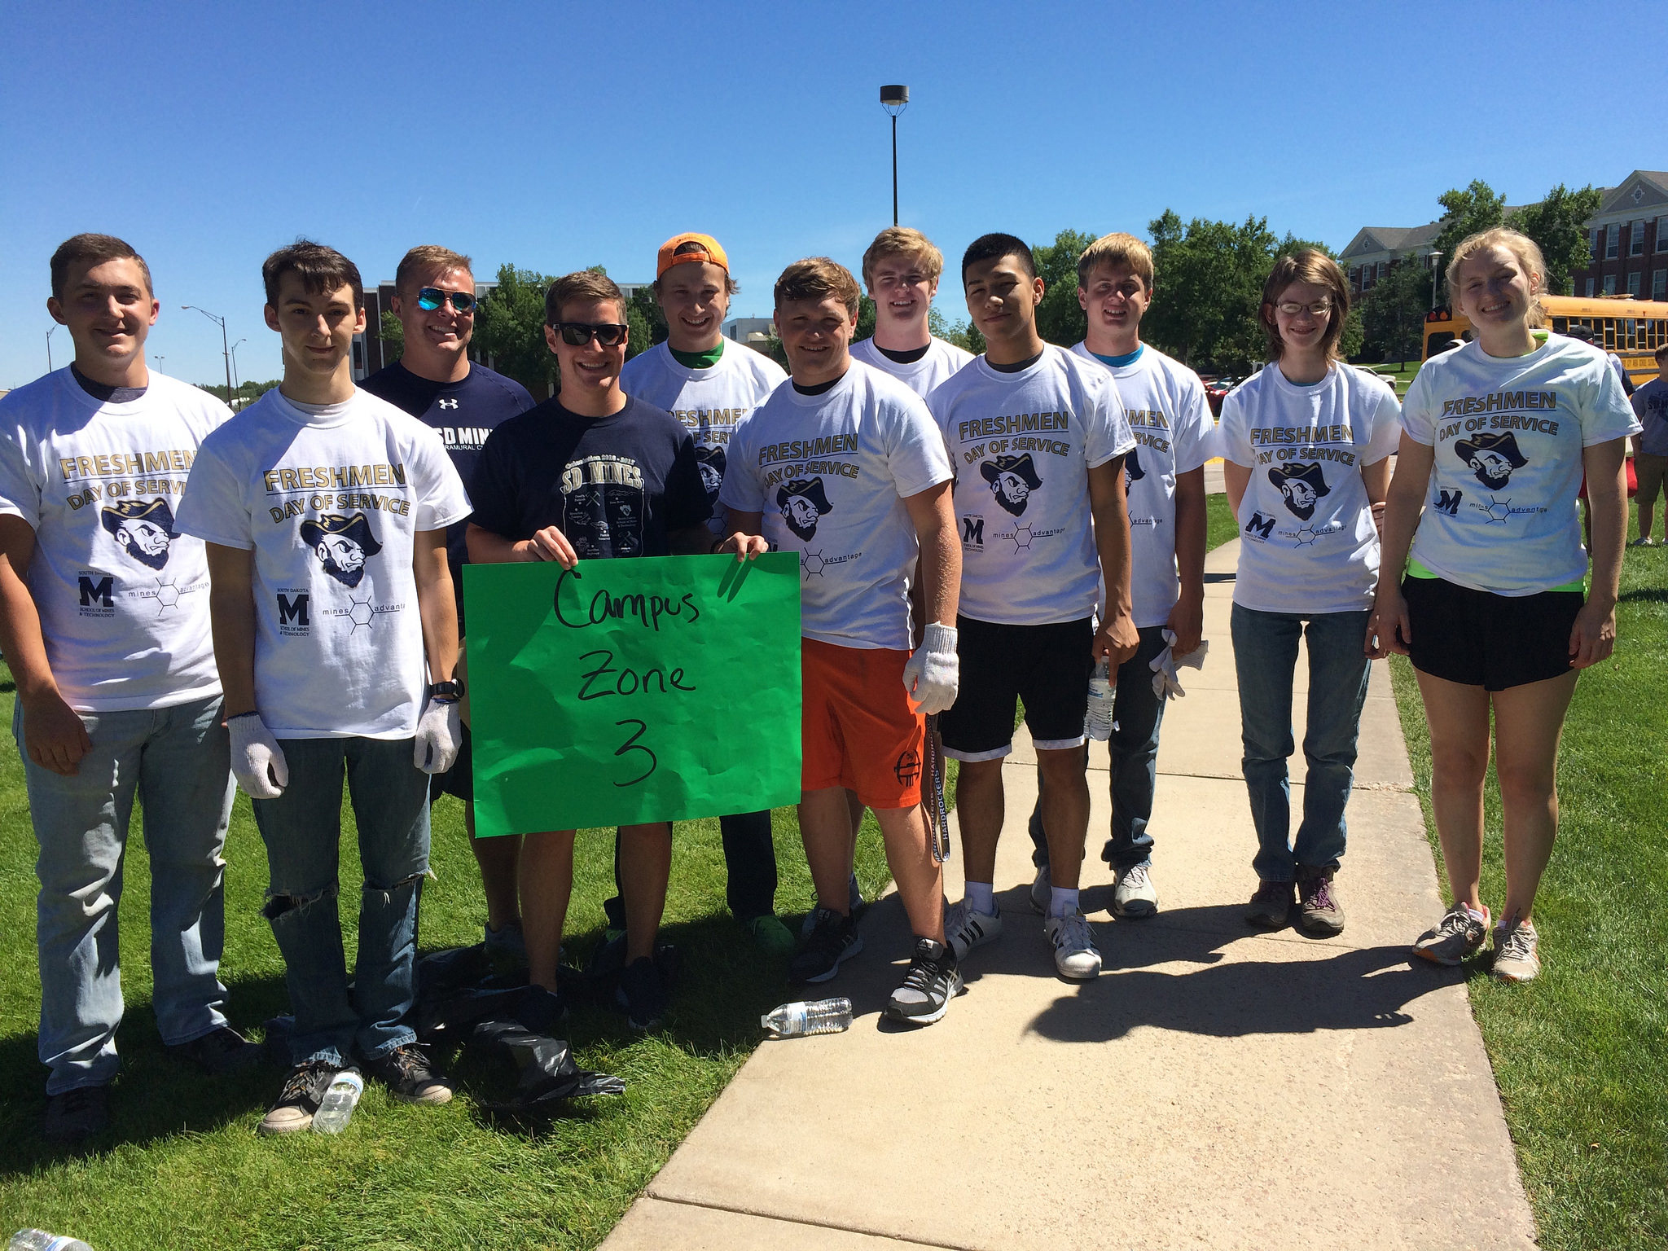
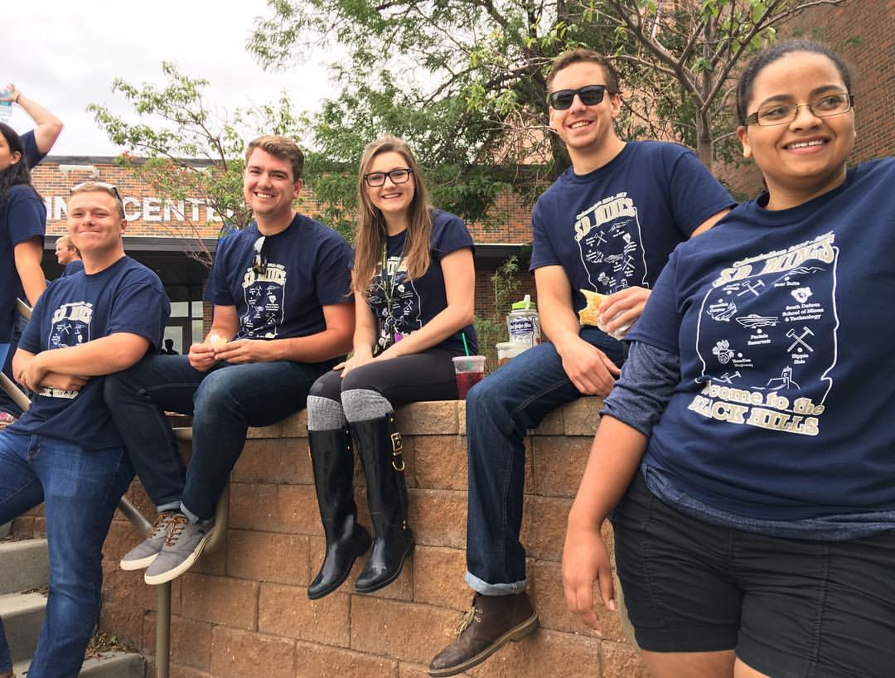
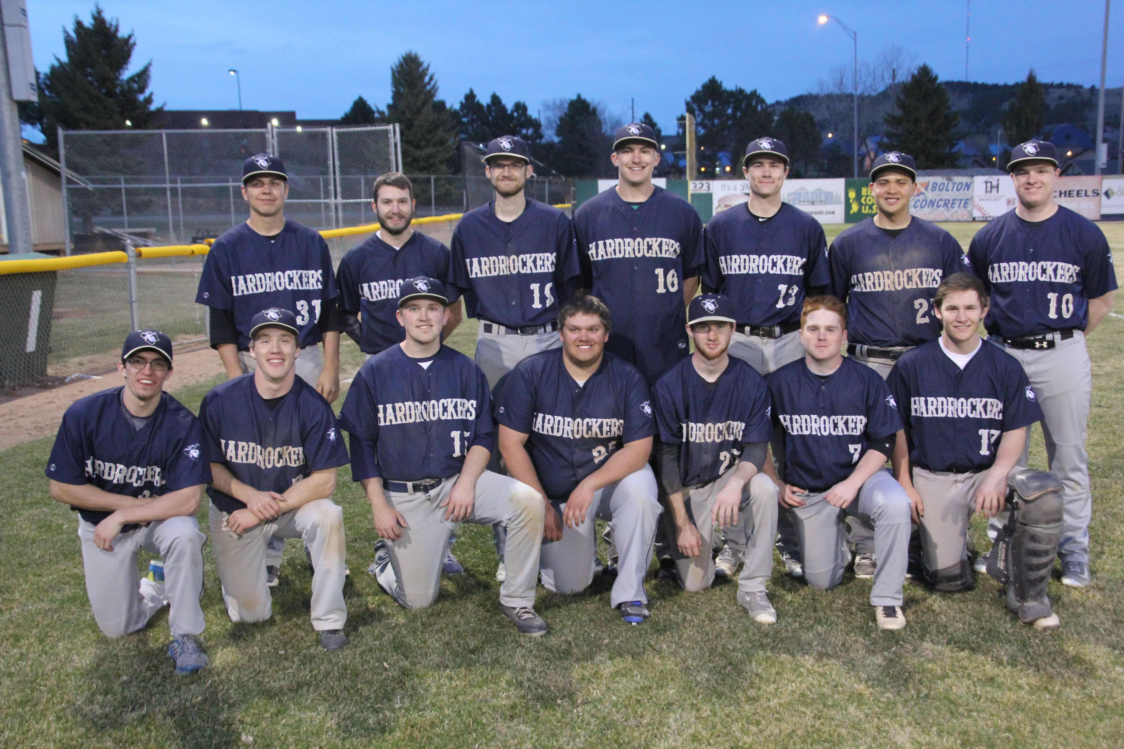
Campus Groups Rocker Shop Has Worked With
Veterans Club
Moon Rockers
Residence Life
Freshman Day of Service
Mines Advantage
PDI
Dean of Students Staff
Student Senate
Hardrocker Club Baseball Team
Circle K
Dublin Dash
Mining and Mucking Team
SD Mines Future Health Science Professionals

Slide 7
REMEMBER:
Plan Ahead
The more lead time = better service and pricing
Graphic File Types
Adobe Illustrator (.AI) or .EPS files are required for apparel items
JPEG/PNG – not print ready for custom apparel
Rocker Shop Offers Competitive Pricing
Special order apparel is sold at a slim margin – usually 10%-20% over cost
Rocker Shop = On-Campus Convenience
Campus and Foundation Accounts are easy to use in store
Order Form – visit our site
Rocker Shop staff has over 40 years experience in selling custom apparel
Rocker Shop is Here to Help
Whether you purchase from Rocker Shop or another licensed vendor, trademark standards need to be followed
Save on Fees
Partnering with UR and the Rocker Shop can save your group art charges and set up fees

Slide 8
KEEP IT ON CAMPUS!!!
100% of revenue generated by
the Rocker Shop goes back into
South Dakota School of Mines & Technology!

