Slide 1
Main Menu
EMERGENCY ASSEMBLY POINT MAP
List of Buildings (click building):
Vanderboom Research Lab (V-Lab)
Chemical and Biological Engineering and Chemistry Building (CBEC)
Civil/Mechanical
Classroom Building
Computational Mechanics Laboratory
Connolly Hall
Electrical Engineering and Physics
Facility Services
Foundry (Not Available)
Howard Peterson Hall
James E. Martin Paleontology Research Center
King Center
Deveraux Library
McLaury
Nucor Mineral Industries
O'Harra
Music Center (Old Gym)
Palmerton Hall
Placer Hall
Rocker Square 1
Rocker Square 2
Surbeck Center
Tech Development Laboratory

Slide 2
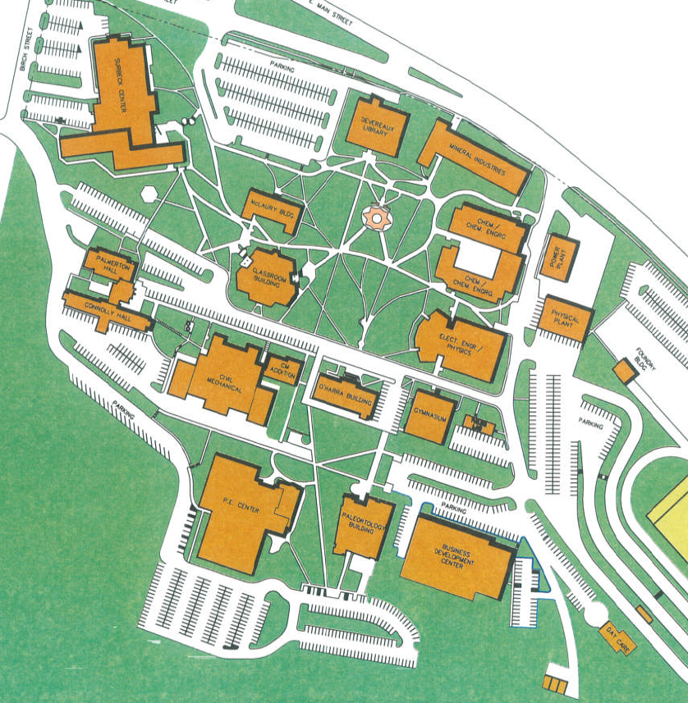
EMERGENCY ASSEMBLY POINT MAP

Slide 3
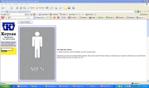
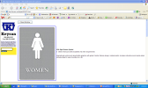
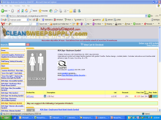
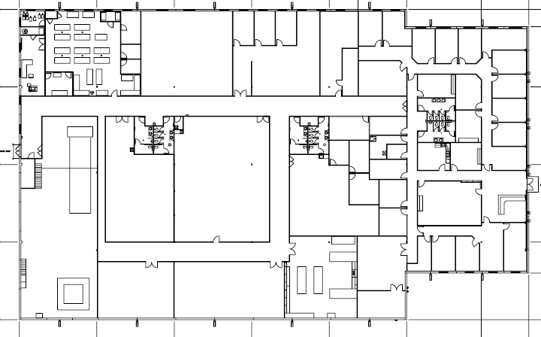
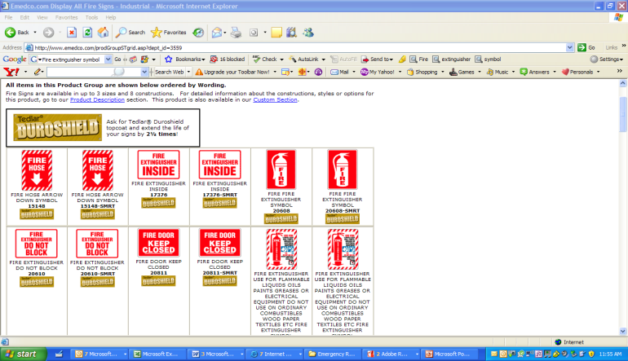
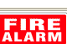

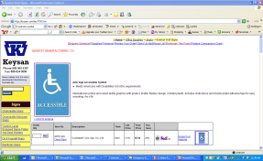



Jessica Humphrey
Todd Curtis
Emergency Assembly Point – Center of North Parking Lot
N
AED
FACP
FACP
FACP
Vanderboom Research Lab (V-Lab)

Slide 4
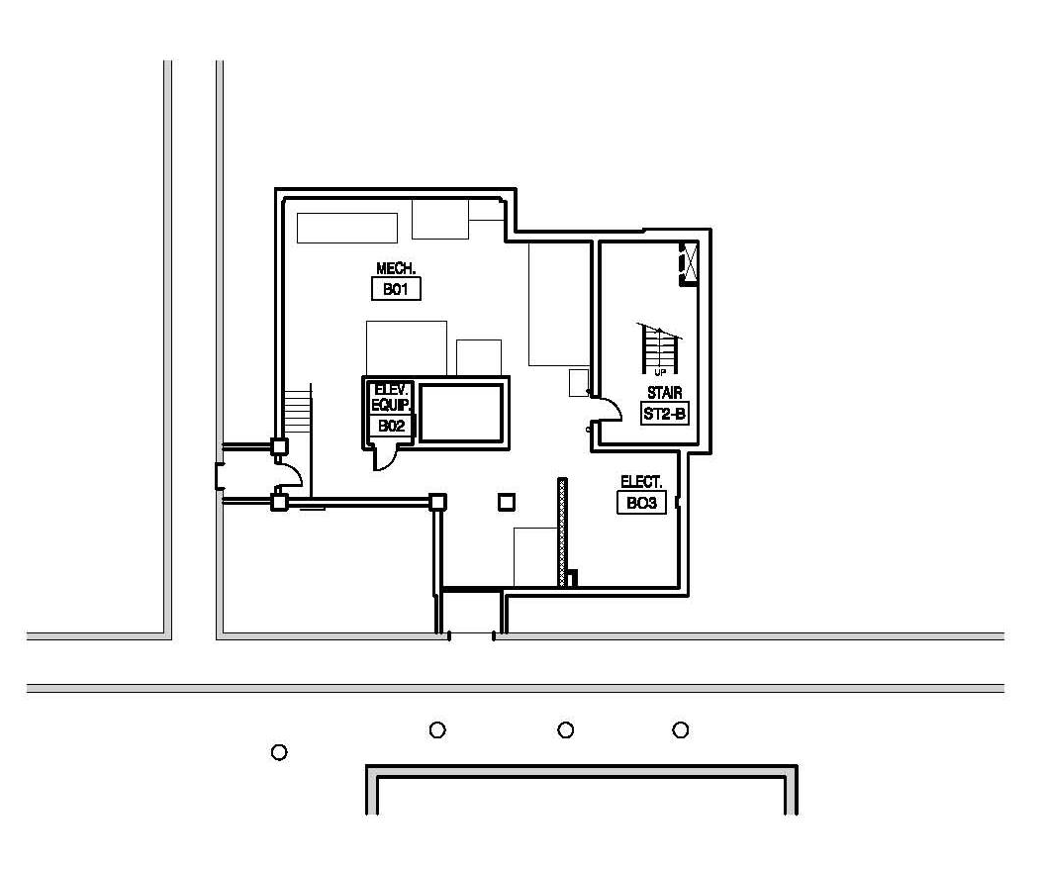
Darren Schwede
Morgan Thomas-Abbott
N
Quad Area (Upwind in the event of a chemical incident.)
Chemical and Biological Engineering Chemistry Building (CBEC)– Basement

Slide 5
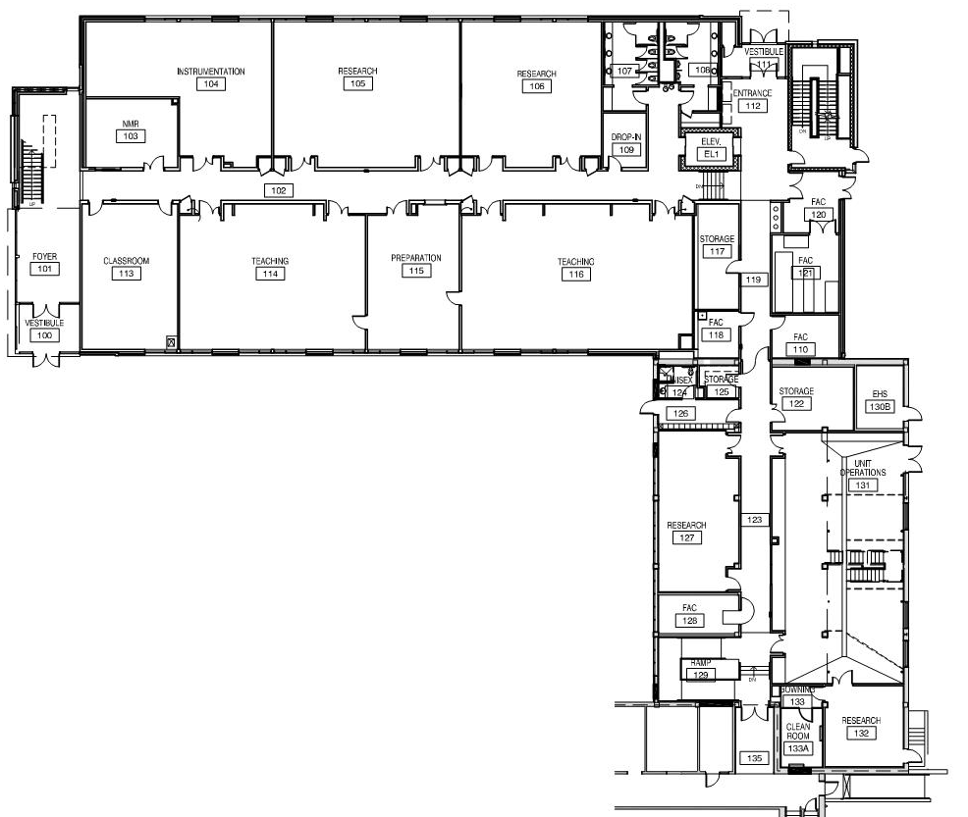
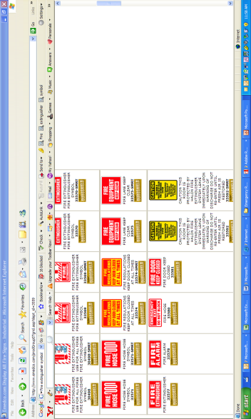
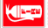
Darren Schwede
Morgan Thomas-Abbott
N
AED
Quad Area (Upwind in the event of a chemical incident.)
FACP
Chemical and Biological Engineering Chemistry Building (CBEC) –
1ST Floor

Slide 6
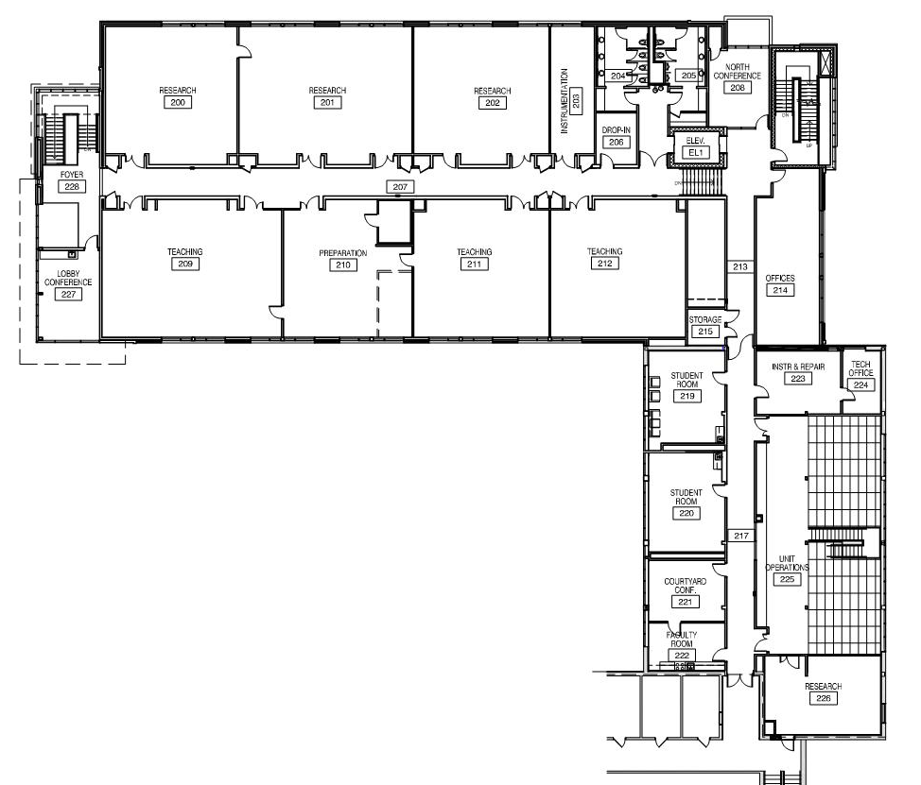
Darren Schwede
Morgan Thomas-Abbott
In the event of a tornado, please proceed to areas marked on the first floor map.
N
Quad Area (Upwind in the event of a chemical incident.)
Chemical and Biological Engineering Chemistry Building (CBEC) –
2ND Floor

Slide 7
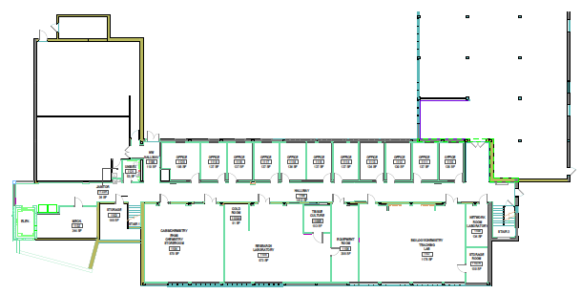
Darren Schwede
Morgan Thomas-Abbott
N
Quad Area (Upwind in the event of a chemical incident.)
Chemical/Biological Engineering and Chemistry South– 1ST FLOOR

Slide 8
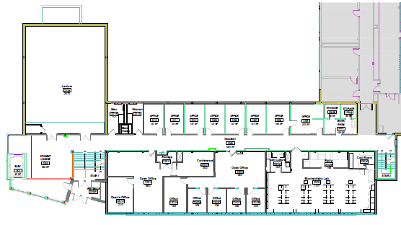
Darren Schwede
Morgan Thomas-Abbott
In the event of a tornado, please proceed to areas marked on the first floor map.
N
Quad Area (Upwind in the event of a chemical incident.)
Chemical/Biological Engineering and Chemistry South – 2ND FLOOR

Slide 9
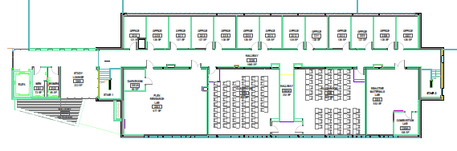
Darren Schwede
Morgan Thomas-Abbott
N
In the event of a tornado, please proceed to areas marked on the first floor map.
Quad Area (Upwind in the event of a chemical incident.)
Chemical/Biological Engineering and Chemistry South – 3RD FLOOR

Slide 10
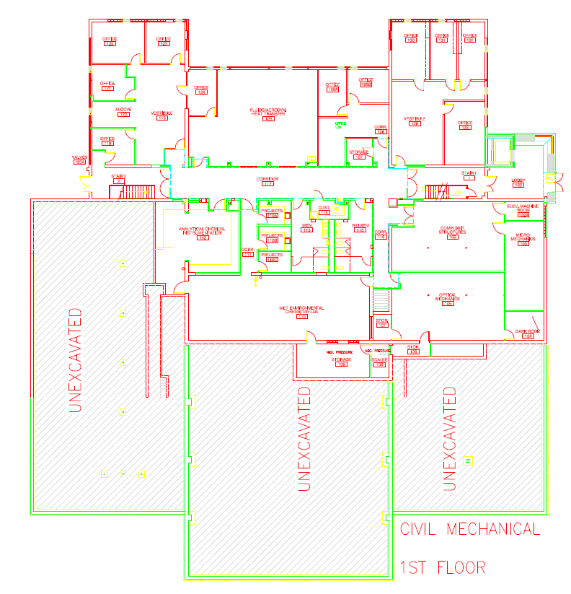
Manny Siragusa
Leslee Moore
Ryan Koontz
N
Flag Pole Across from O’Harra Building
FACP
Civil/Mechanical – 1ST FLOOR

Slide 11
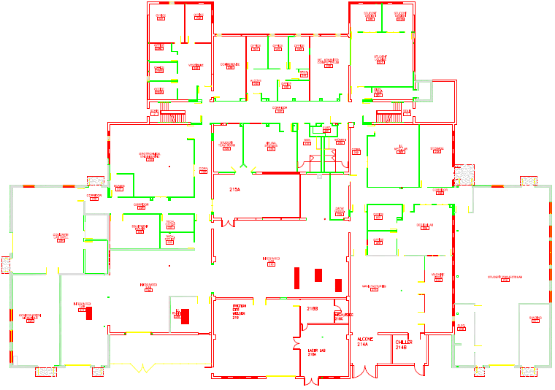
Manny Siragusa
Leslee Moore
Ryan Koontz
In the event of a tornado, please proceed to areas marked on the first floor map.
N
Flag Pole Across from O’Harra Building
Exit on 1ST Floor
AED
Exit on 1ST Floor
FACP
Civil/Mechanical – 2ND FLOOR

Slide 12
Manny Siragusa
Leslee Moore
Ryan Koontz
In the event of a tornado, please proceed to areas marked on the first floor map.
N
Flag Pole Across from O’Harra Building
Exit on 1ST Floor
Exit on 1ST Floor
Civil/Mechanical – 3RD FLOOR

Slide 13
Christy Tidwell
Margaret Smallbrock
Exit at top of staircase
N
Quad Area
Exit on 2nd Floor
Exit on 2nd Floor
CLASSROOM BUILDING – 1st FLOOR

Slide 14
Christy Tidwell
Margaret Smallbrock
Exit at bottom of staircase
N
Quad Area
AED
FACP
CLASSROOM BUILDING – 2nd FLOOR

Slide 15
Christy Tidwell
Margaret Smallbrock
In the event of a tornado, please proceed to areas marked on the first and second floor maps.
N
Quad Area
Exit on 2nd Floor
Exit on 2nd Floor
Exit on 2nd Floor
Exit on 2nd Floor
CLASSROOM BUILDING – 3rd FLOOR

Slide 16
Manny Siragusa
Leslee Moore
Ryan Koontz
N
Flag Pole Across from O’Harra Building
AED
Computational Mechanics - 1st Floor

Slide 17
Manny Siragusa
Leslee Moore
Ryan Koontz
In the event of a tornado, please proceed to areas marked on the first floor map.
N
Flag Pole Across from O’Harra Building
Computational Mechanics - 2nd Floor

Slide 18
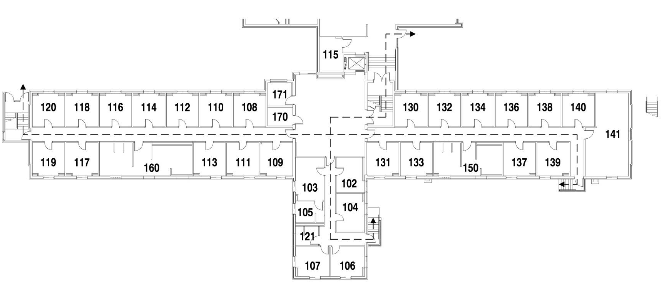
Katie Wahls
Bryce Nussbaum
The Emergency Assembly Points are located in the March/Dake Plaza and the Civil/Mechanical courtyard area.
N
FACP
CONNOLLY HALL – 1st FLOOR

Slide 19
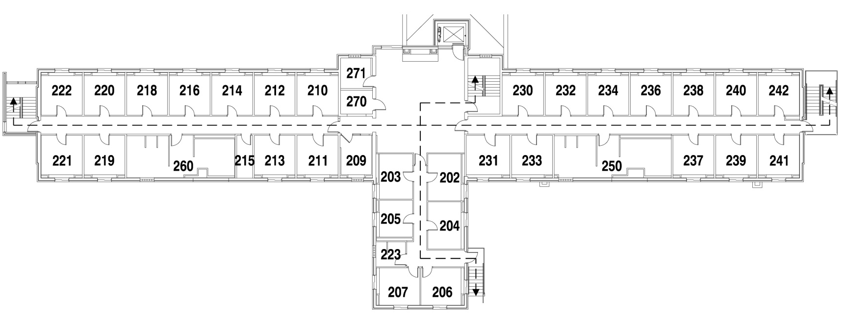
Katie Wahls
Bryce Nussbaum
The Emergency Assembly Points are located in the March/Dake Plaza and the Civil/Mechanical courtyard area.
N
In the event of a tornado, please proceed to areas marked on the first floor map.
CONNOLLY HALL – 2nd FLOOR

Slide 20
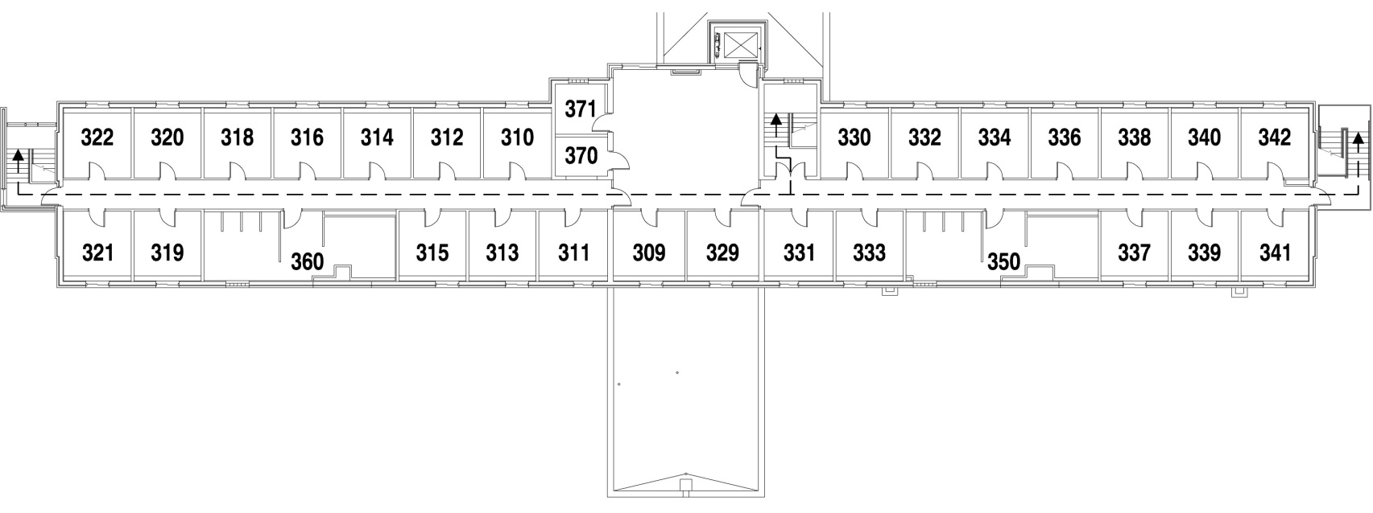
Katie Wahls
Bryce Nussbaum
The Emergency Assembly Points are located in the March/Dake Plaza and the Civil/Mechanical courtyard area.
N
In the event of a tornado, please proceed to areas marked on the first floor map.
CONNOLLY HALL– 3rd FLOOR

Slide 21
Brad O’’Brien, Jason Erickson
Connie Krosschell, Jen Dusek
N
Quad Area
FACP
ELECTRICAL ENGINEERING/PHYSICS – 1ST FLOOR

Slide 22
Brad O’’Brien, Jason Erickson
Connie Krosschell, Jen Dusek
N
In the event of a tornado, please proceed to areas marked on the first floor map.
Quad Area
AED
ELECTRICAL ENGINEERING/PHYSICS – 2ND FLOOR

Slide 23
Brad O’’Brien, Jason Erickson
Connie Krosschell, Jen Dusek
N
In the event of a tornado, please proceed to areas marked on the first floor map.
Quad Area
ELECTRICAL ENGINEERING/PHYSICS – 3RD FLOOR

Slide 24
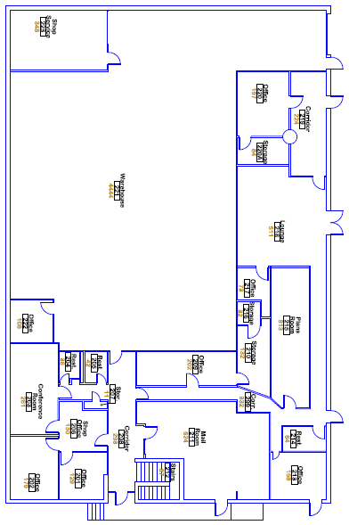
Catherine Helgeson
Margaret Smallbrock
In the event of a tornado, take shelter in the shop area away from windows and equipment.
N
South Parking Lot
FACP
FACP – Located at bottom of stairs.
First aid kit located in shop area on first floor.
Facility Services– 1st Floor

Slide 25
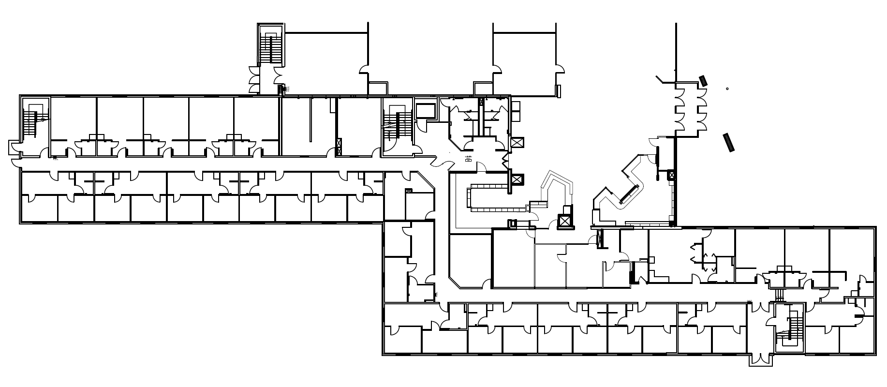
Katie Wahls
Bryce Nussbaum
N
The Emergency Assembly Point is located in the March/Dake Plaza.
FACP
The main Fire Alarm Control Panel is located at the West Surbeck Center entrance.
FACP
2 AED’s are located in Surbeck Center
Down the bookstore hallway across from Student Health
Across from the Dining Services Office
HOWARD PETERSON HALL – 1ST FLOOR

Slide 26
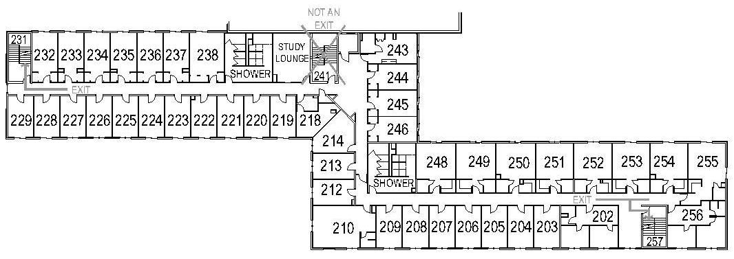
Katie Wahls
Bryce Nussbaum
N
The Emergency Assembly Point is located in the March/Dake Plaza.
In the event of a tornado, please proceed to areas marked on the first floor map.
HOWARD PETERSON HALL – 2ND FLOOR

Slide 27
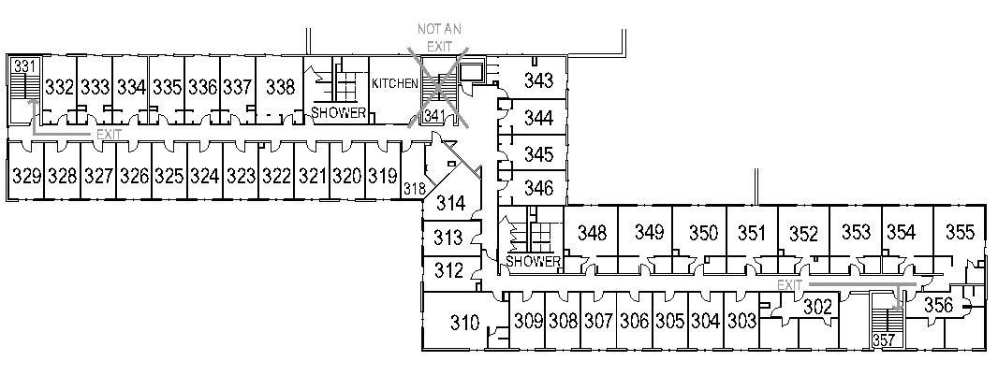
Katie Wahls
Bryce Nussbaum
N
The Emergency Assembly Point is located in the March/Dake Plaza.
In the event of a tornado, please proceed to areas marked on the first floor map.
HOWARD PETERSON HALL – 3RD FLOOR

Slide 28
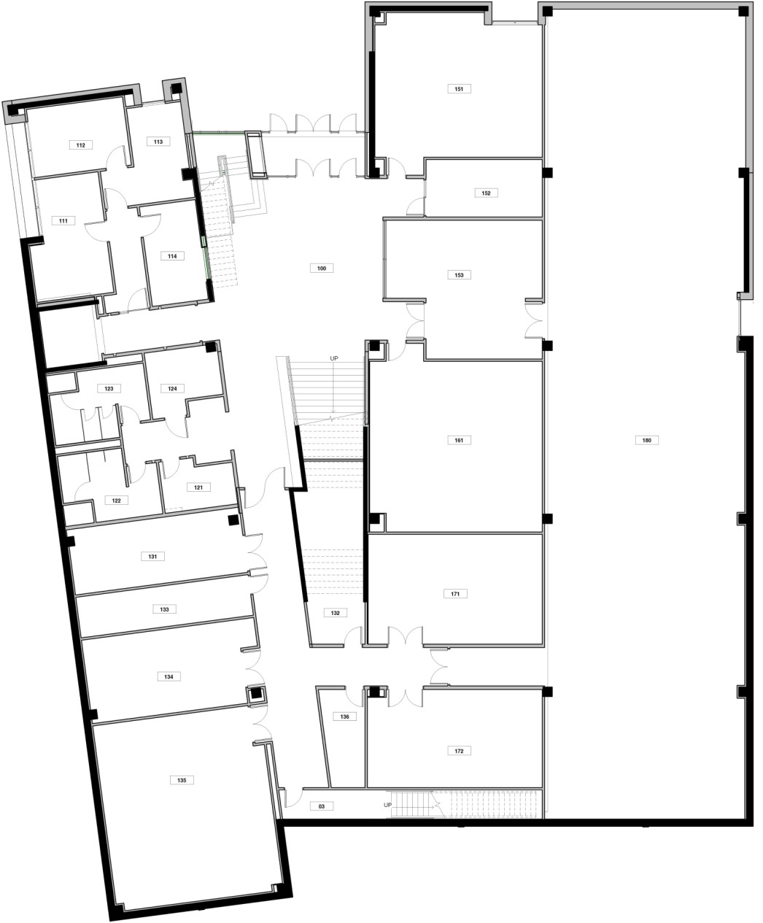
Samantha Wright
Darrin Pagnac
N
FACP
AED
FACP
Exit at top of staircase
James E. Martin Paleontology Research Center – 1ST Floor

Slide 29
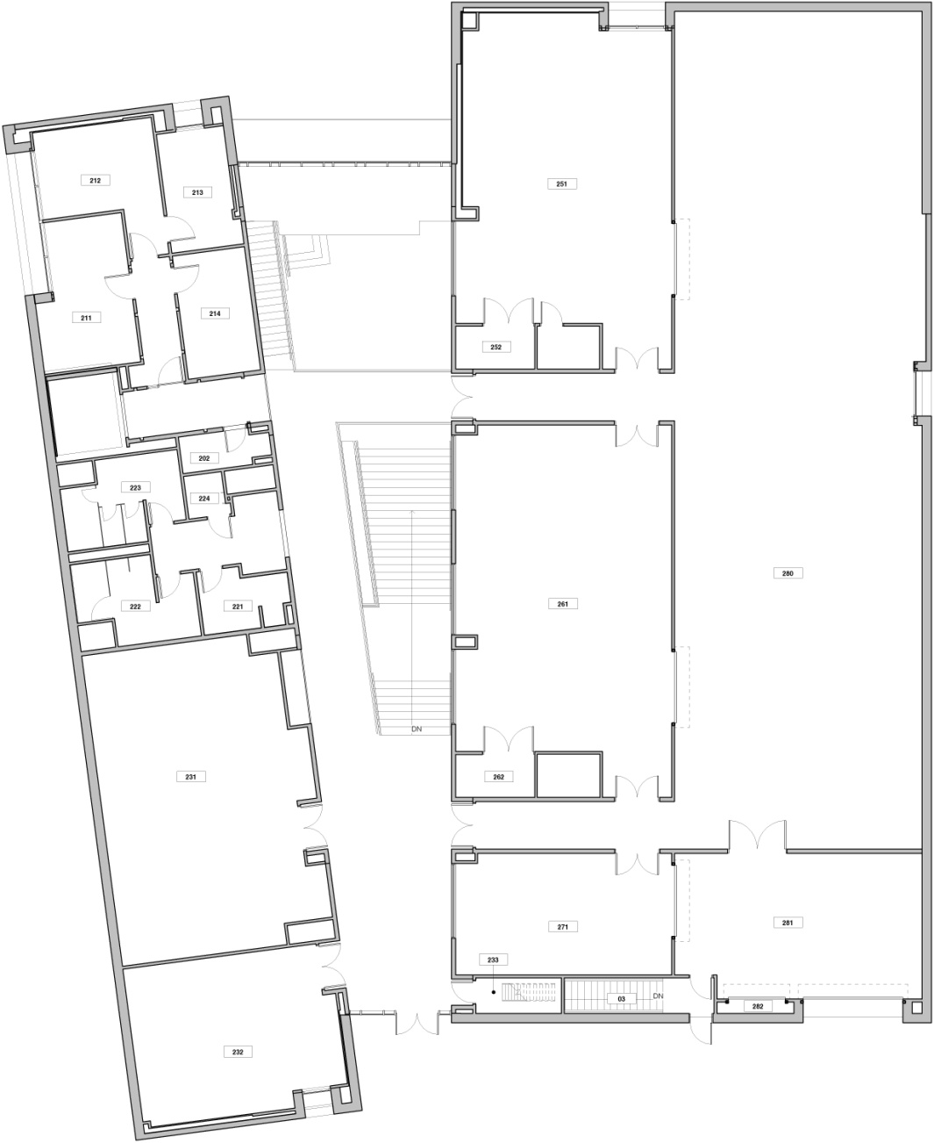
Samantha Wright
Darrin Pagnac
In the event of a tornado, please proceed to areas marked on the first floor map.
N
Exit at bottom of staircase
James E. Martin Paleontology Research Center– 2ND FLOOR

Slide 30
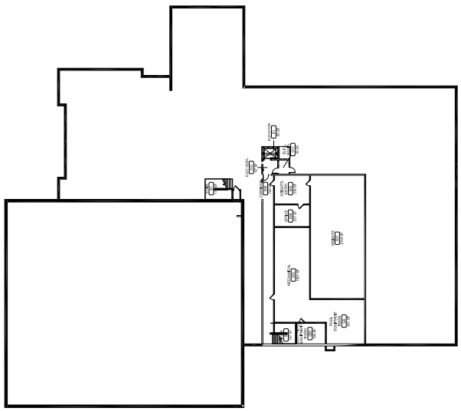
Anita Brenneman
Seth Nichols
N
FACP
King Center – BASEMENT

Slide 31
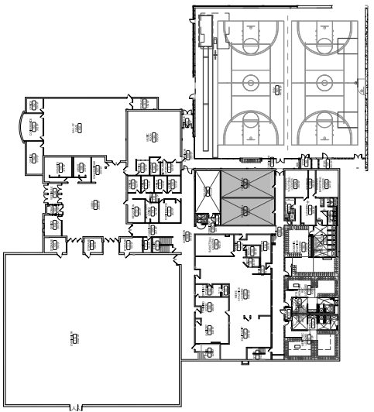
Anita Brenneman
Seth Nichols
In the event of a tornado, please proceed to areas marked on the first floor map.
N
AED
King Center – 1ST FLOOR

Slide 32
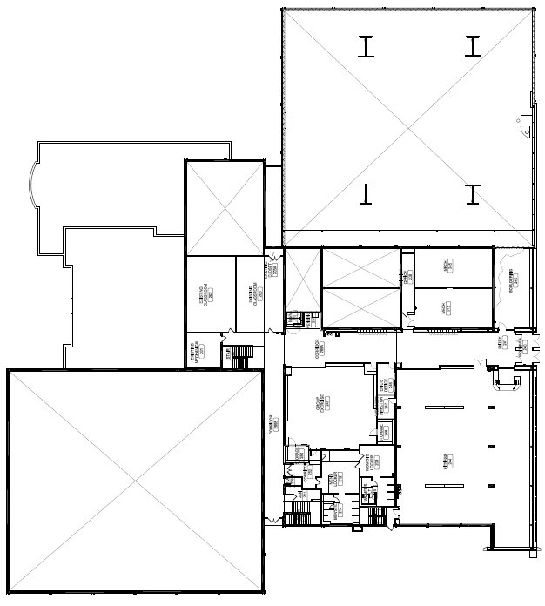
Anita Brenneman
Seth Nichols
In the event of a tornado, please proceed to areas marked on the first floor map.
N
AED
King Center – 2ND FLOOR

Slide 33
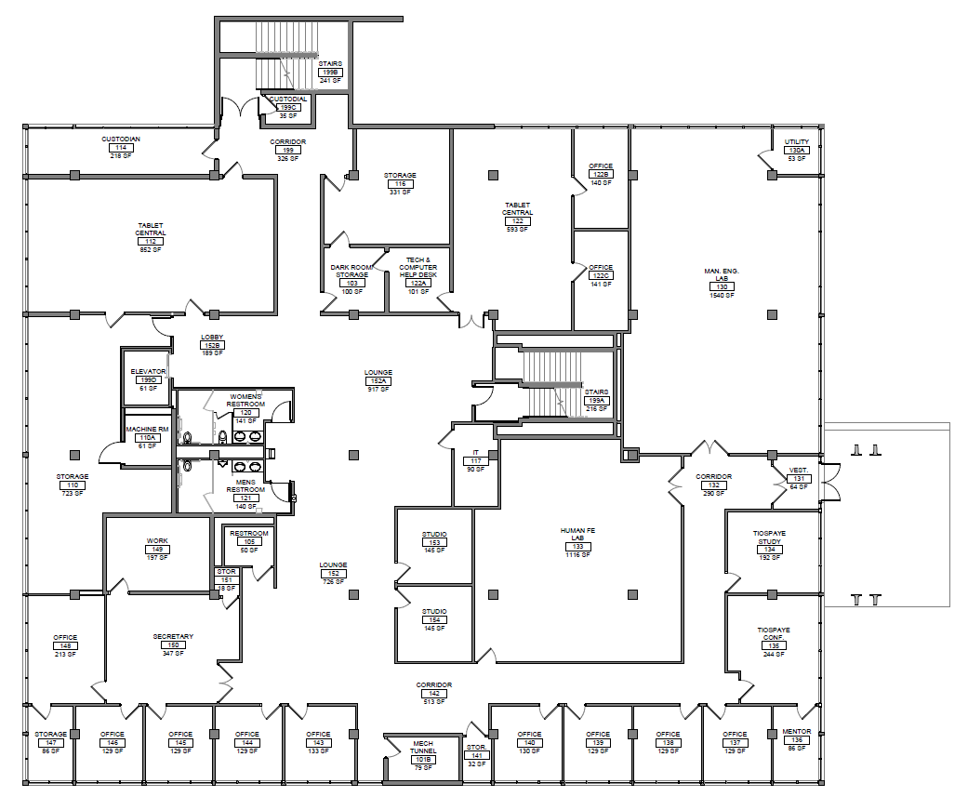

Janet Taylor
Lisa Carlson
Christal Krein
N
Quad Area
Library– Lower Level

Slide 34
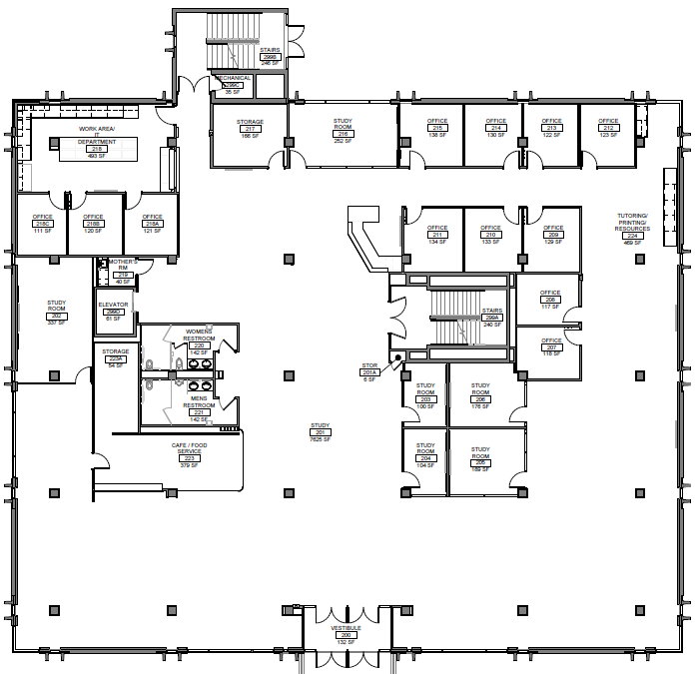
Janet Taylor
Lisa Carlson
Christal Krein
In the event of a tornado, please proceed to areas marked on the first floor map.
N
Exit on Basement Floor
AED
Fire Alarm Control Panel for Monitoring Only – Main Panel on top floor
FACP
Quad Area
Library– Main Level

Slide 35
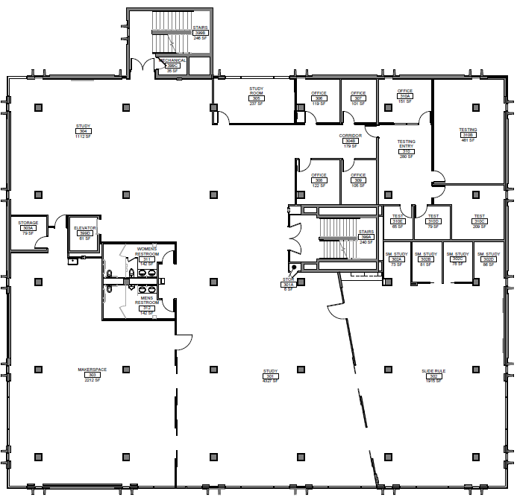
Janet Taylor
Lisa Carlson
Christal Krein
In the event of a tornado, please proceed to areas marked on the first floor map.
N
Exit on Lower and Main Levels
Quad Area
Library– 3rd FLOOR

Slide 36
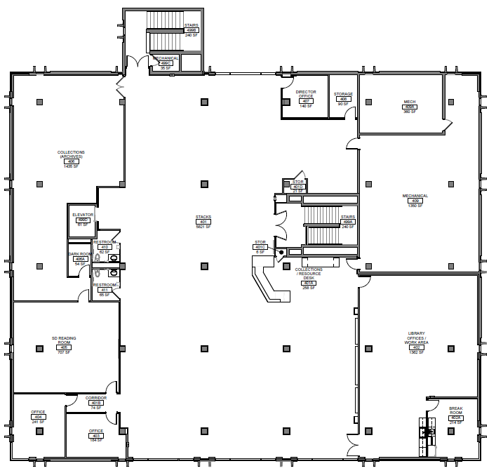
Janet Taylor
Lisa Carlson
Christal Krein
In the event of a tornado, please proceed to areas marked on the first floor map.
N
Exit on outside exit or out main level
Exit on Lower and Main Levels
FACP
Quad Area
Library– 4th FLOOR

Slide 37
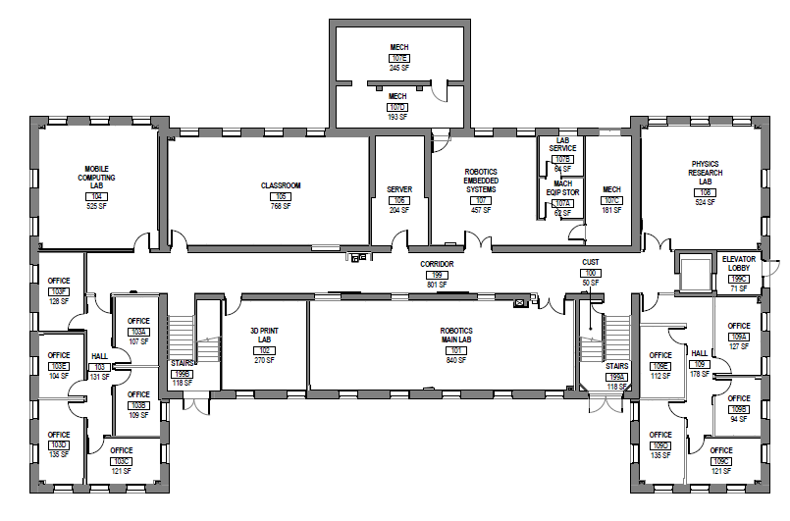
Dr. Travis Kowalski
Cathy Durkin
N
FACP
Quad Area
McLaury – 1ST FLOOR

Slide 38
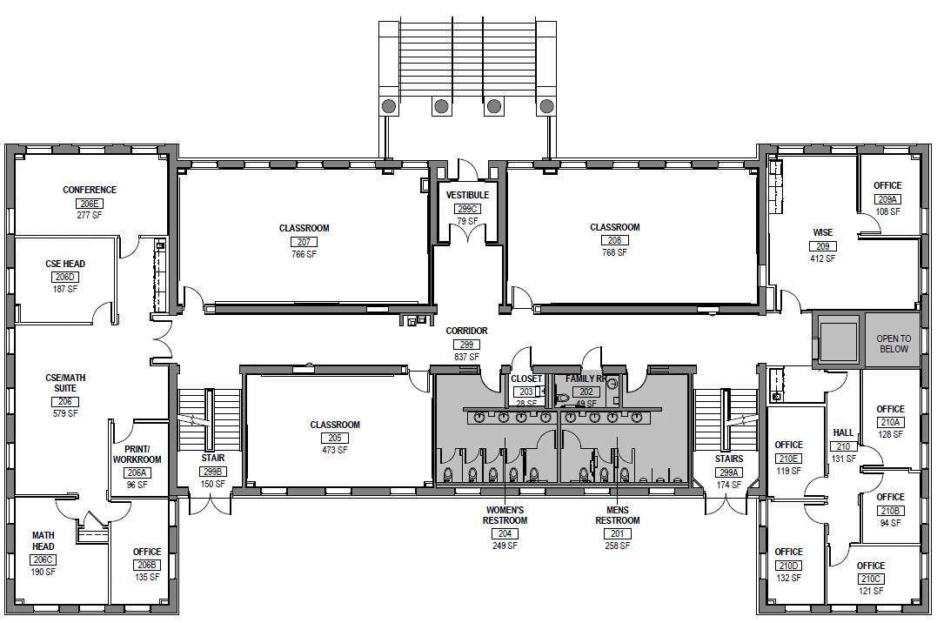
Dr. Travis Kowalski
Cathy Durkin
In the event of a tornado, please proceed to areas marked on the first floor map.
N
Quad Area
McLaury – 2ND FLOOR

Slide 39
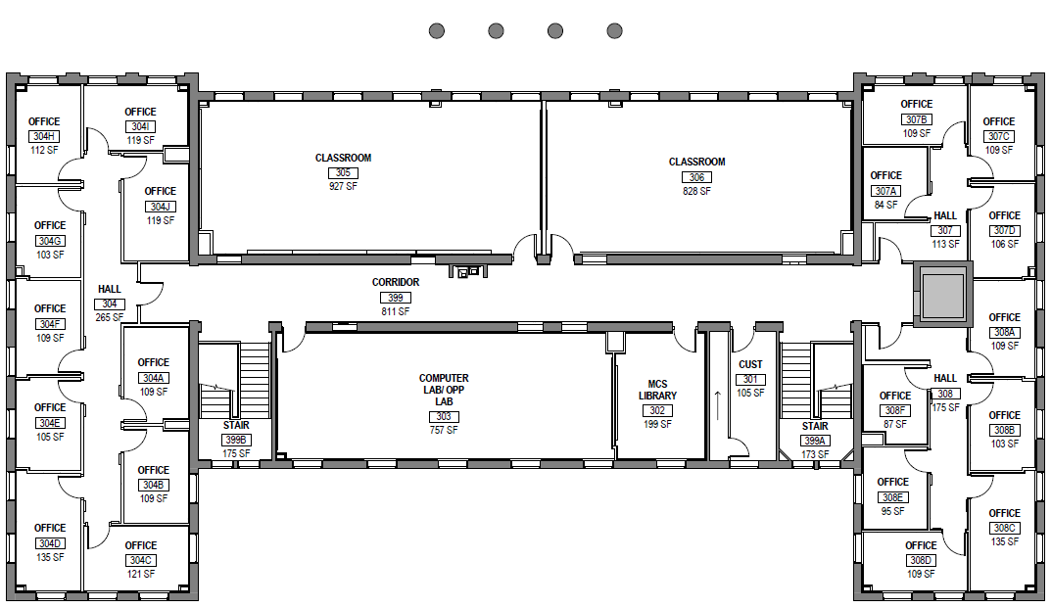
Dr. Travis Kowalski
Cathy Durkin
In the event of a tornado, please proceed to areas marked on the first floor map.
N
Exit out the Main Door to the North from the second floor, or out the doors closest to classroom building to the south.
Quad Area
McLaury – 3RD FLOOR

Slide 40
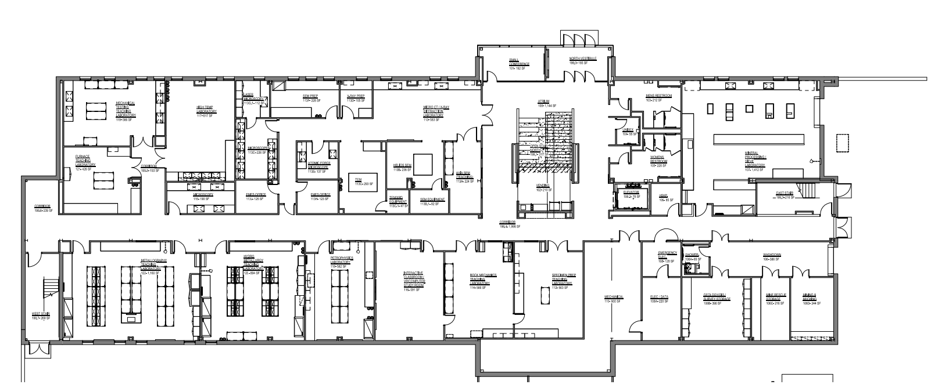

Parker Pombrio
Jessica Zacher
Jennifer Parrow
N
Exit on 1ST Floor
Exit on 1ST Floor
NUCOR MINERAL INDUSTRY BUILDING – 1ST FLOOR

Slide 41
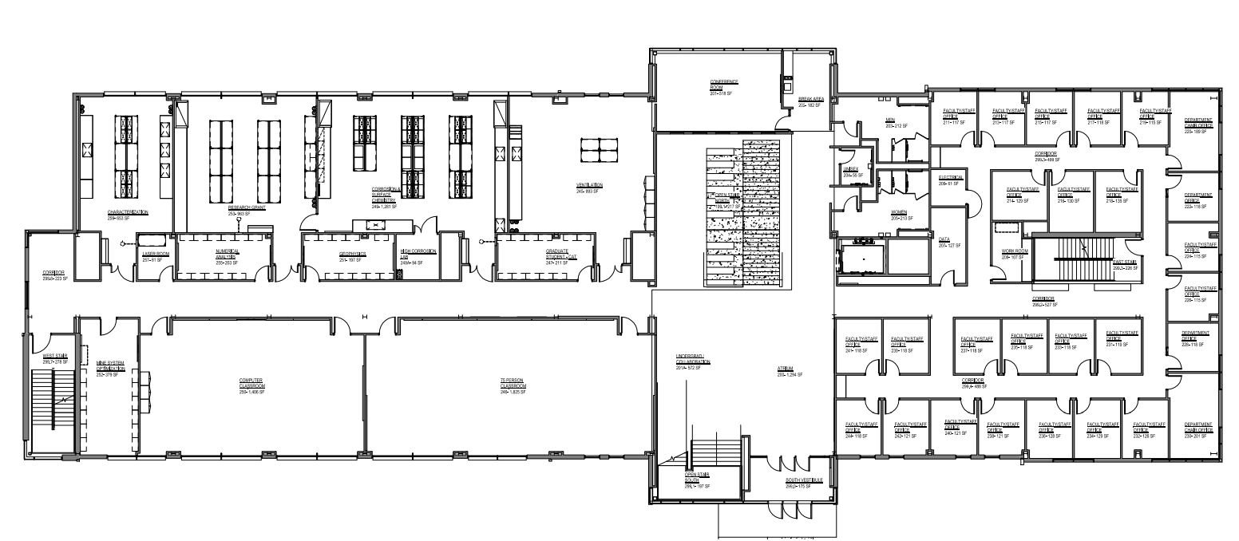
Parker Pombrio
Jessica Zacher
Jennifer Parrow
In the event of a tornado, please proceed to areas marked on the first and second floor maps.
N
Exit on 1ST Floor
AED
Exit on 1ST Floor
NUCOR MINERAL INDUSTRY BUILDING – 2ND FLOOR

Slide 42
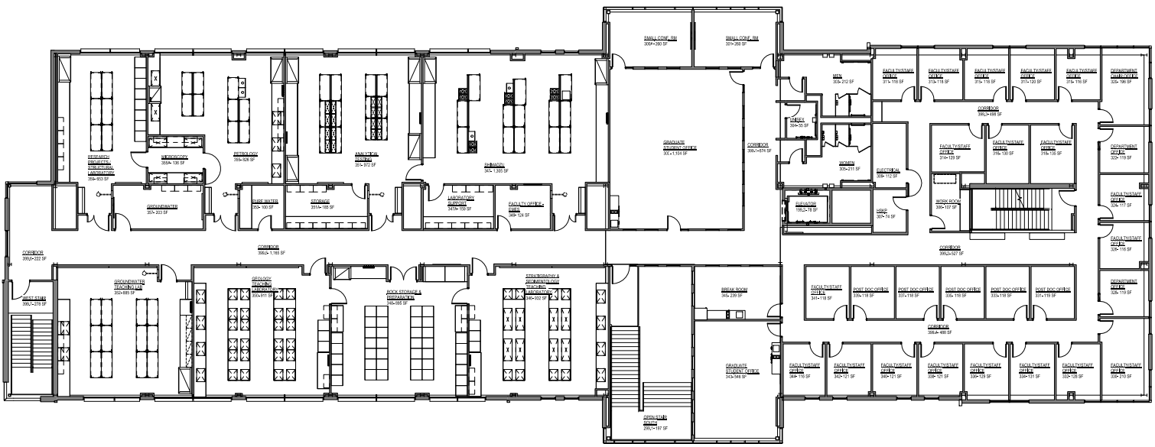
Parker Pombrio
Jessica Zacher
Jennifer Parrow
In the event of a tornado, please proceed to areas marked on the first and second floor maps.
N
Exit on 1ST Floor
Exit on 1ST Floor
NUCOR MINERAL INDUSTRY BUILDING – 3RD FLOOR

Slide 43
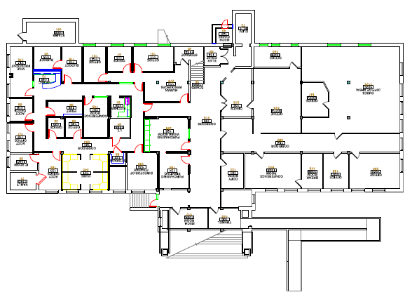
Angela Mettler
Gina Fiorello
Aaron Grimm, Darrah Steffen
N
Exit at top of staircase
FACP
Flag Pole Across Street
O’HARRA BUILDING – 1ST FLOOR

Slide 44
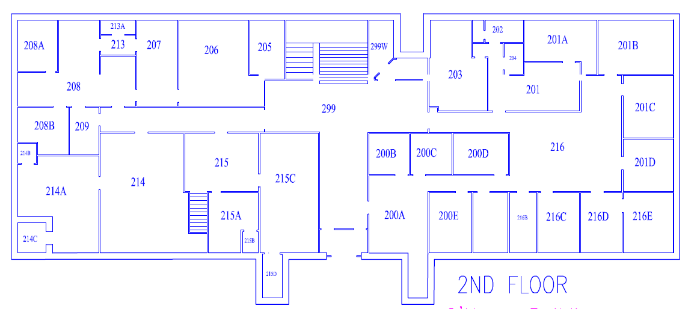
Angela Mettler
Gina Fiorello
Aaron Grimm, Darrah Steffen
In the event of a tornado, please proceed to areas marked on the first floor map.
N
Exit at bottom of stairs
AED
Flag Pole Across Street
O’HARRA BUILDING – 2ND FLOOR

Slide 45
Angela Mettler
Gina Fiorello
Aaron Grimm, Darrah Steffen
In the event of a tornado, please proceed to areas marked on the first floor map.
N
Exit on 1ST Floor
Exit on 2nd Floor
Flag Pole Across Street
O’HARRA BUILDING – 3RD FLOOR

Slide 46
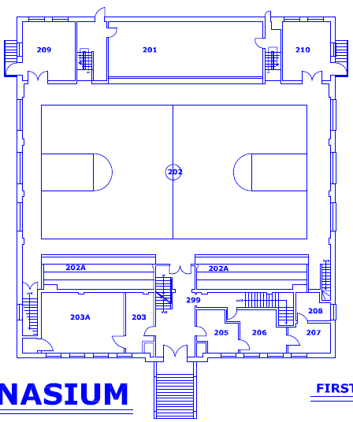
Facility Service needs to assist for emergency. Nonemergency-Haley Armstrong
N
Flag Pole Across Street
Music Center – 2ND FLOOR

Slide 47
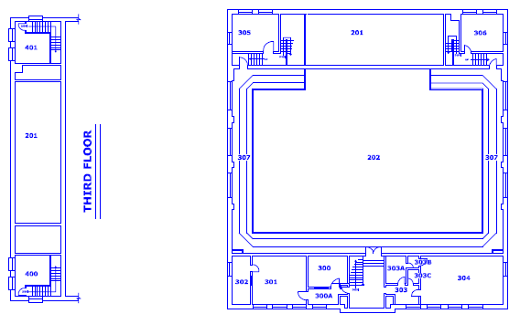
Facility Service needs to assist for emergency. Nonemergency-Haley Armstrong
N
Exit at bottom of staircase
Exit at bottom of staircase
Exit at bottom of staircase
Exit at bottom of staircase
Exit at bottom of staircase
Flag Pole Across Street
Music Center– 3RD FLOOR

Slide 48
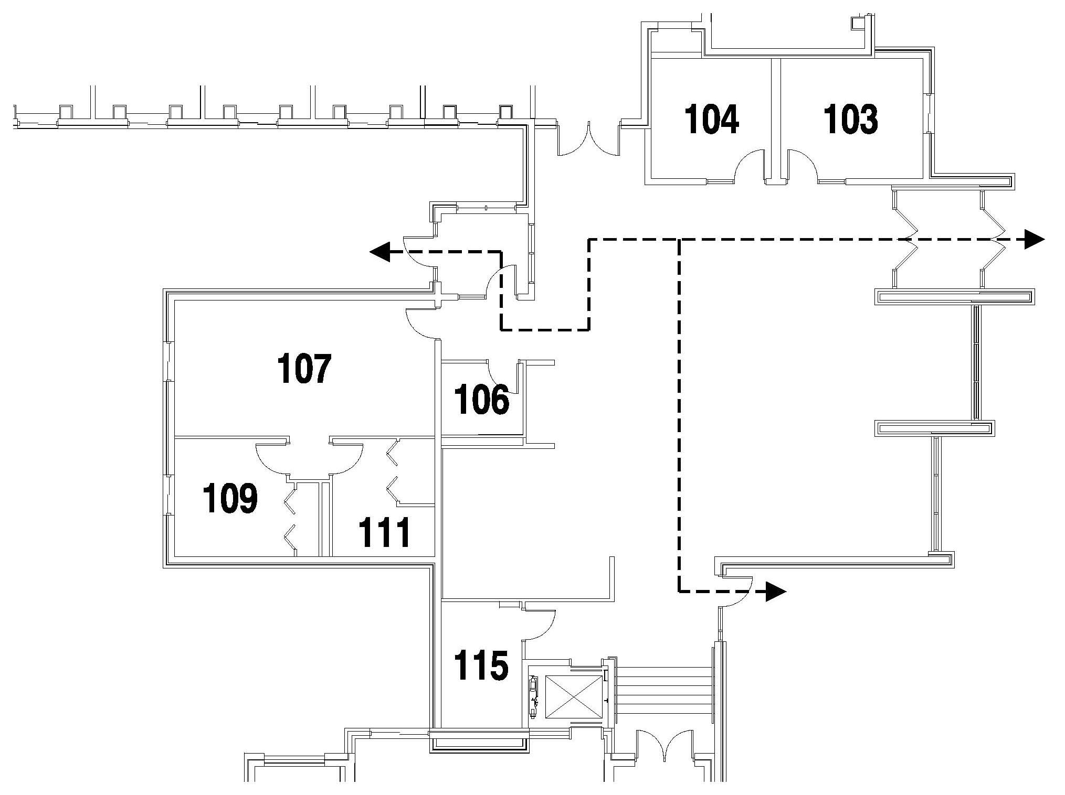
Katie Wahls
Bryce Nussbaum
The Emergency Assembly Points are located in the March/Dake Plaza and the Civil/Mechanical courtyard area.
N
AED
FACP
PALMERTON HALL – Commons

Slide 49
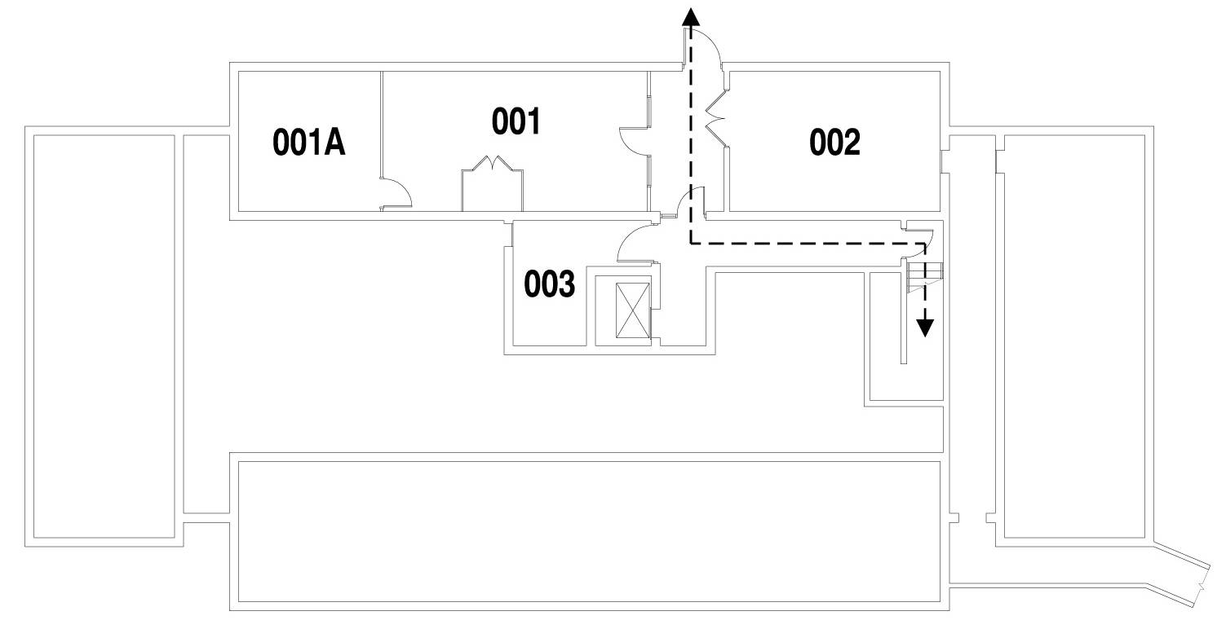
Katie Wahls
Bryce Nussbaum
The Emergency Assembly Points are located in the March/Dake Plaza and the Civil/Mechanical courtyard area.
N
PALMERTON HALL – BASEMENT

Slide 50
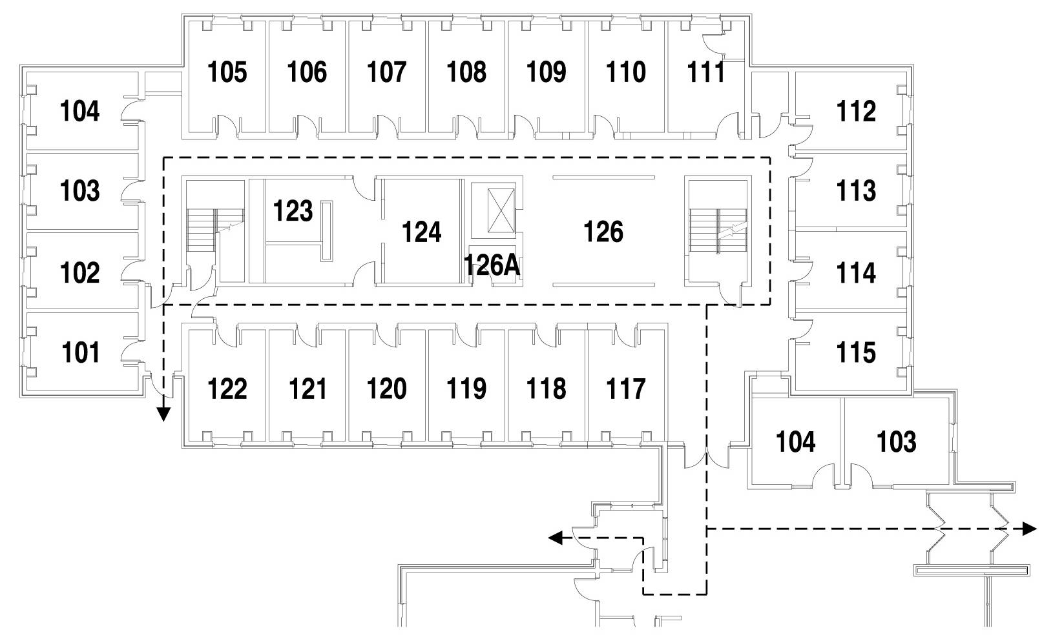
Katie Wahls
Bryce Nussbaum
The Emergency Assembly Points are located in the March/Dake Plaza and the Civil/Mechanical courtyard area.
N
AED
FACP
PALMERTON HALL – 1ST FLOOR

Slide 51
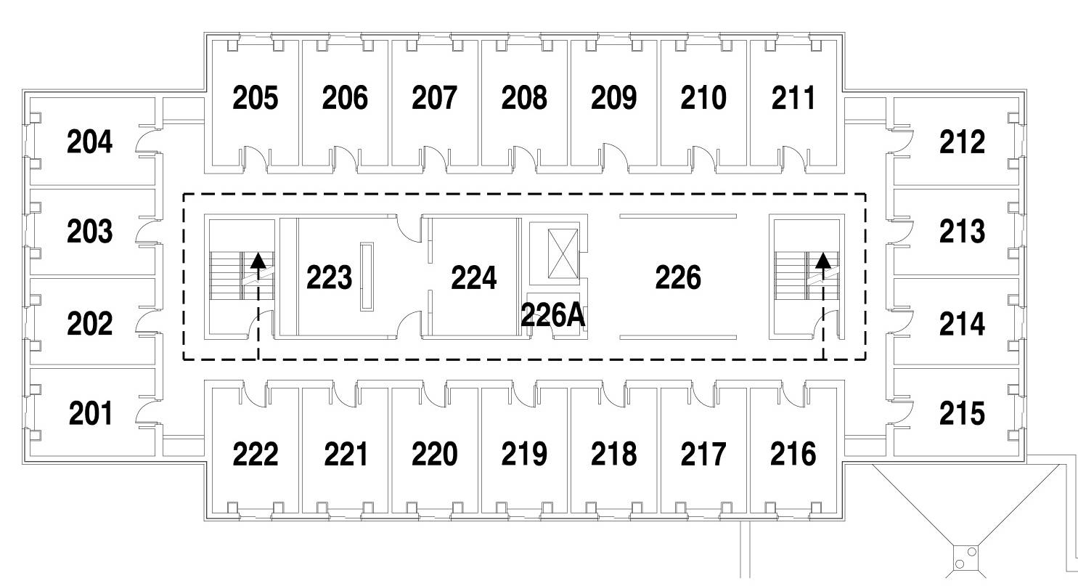
Katie Wahls
Bryce Nussbaum
The Emergency Assembly Points are located in the March/Dake Plaza and the Civil/Mechanical courtyard area.
N
In the event of a tornado, please proceed to areas marked on the commons, basement, and first floor map.
Exit on 1ST Floor
Exit on 1ST Floor
PALMERTON HALL – 2ND FLOOR

Slide 52

Katie Wahls
Bryce Nussbaum
The Emergency Assembly Points are located in the March/Dake Plaza and the Civil/Mechanical courtyard area.
N
In the event of a tornado, please proceed to areas marked on the commons, basement, and first floor map.
Exit on 1ST Floor
Exit on 1ST Floor
PALMERTON HALL – 3RD FLOOR

Slide 53

Katie Wahls
Bryce Nussbaum
The Emergency Assembly Points are located in the March/Dake Plaza and the Civil/Mechanical courtyard area.
N
In the event of a tornado, please proceed to areas marked on the commons, basement, and first floor map.
Exit on 1ST Floor
Exit on 1ST Floor
PALMERTON HALL – 4TH FLOOR

Slide 54

Katie Wahls
Bryce Nussbaum
The Emergency Assembly Points are located in the March/Dake Plaza and the Civil/Mechanical courtyard area.
N
In the event of a tornado, please proceed to areas marked on the commons, basement, and first floor map.
Exit on 1ST Floor
Exit on 1ST Floor
PALMERTON HALL – 5TH FLOOR

Slide 55
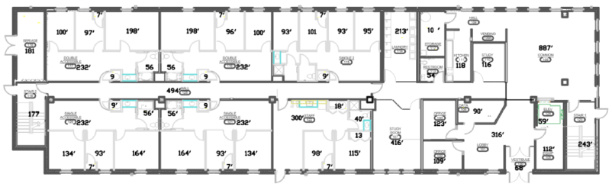
Katie Wahls
Bryce Nussbaum
N
In the event of a tornado, please proceed to areas marked on the first floor map.
FACP
FACP
Placer Hall – 1st Floor

Slide 56
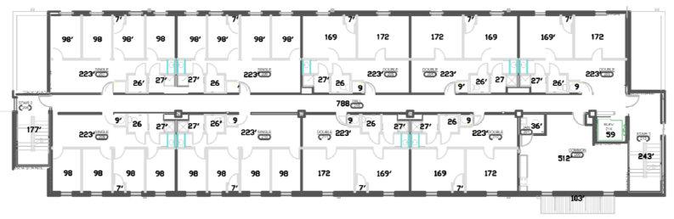
Katie Wahls
Bryce Nussbaum
N
In the event of a tornado, please proceed to areas marked on the first floor map.
Placer Hall – 2nd, 3rd, 5th Floors

Slide 57

Katie Wahls
Bryce Nussbaum
N
In the event of a tornado, please proceed to areas marked on the first floor map.
Placer Hall – 3rd Floor

Slide 58

Katie Wahls
Bryce Nussbaum
N
In the event of a tornado, please proceed to areas marked on the first floor map.
Placer Hall – 4th and 6th Floors

Slide 59

Katie Wahls
Bryce Nussbaum
N
In the event of a tornado, please proceed to areas marked on the first floor map.
Placer Hall – 5th Floor

Slide 60

Katie Wahls
Bryce Nussbaum
N
In the event of a tornado, please proceed to areas marked on the first floor map.
Placer Hall – 6th Floor

Slide 61

Katie Wahls
Bryce Nussbaum
In the event of a tornado, please proceed to areas marked on the first floor map.
N
Rocker Square 1 – 1st Floor

Slide 62

Katie Wahls
Bryce Nussbaum
In the event of a tornado, please proceed to areas marked on the first floor map.
N
Rocker Square 1 – 2nd through 6th Floor

Slide 63
Katie Wahls
Bryce Nussbaum
In the event of a tornado, please proceed to areas marked on the first floor map.
N
Rocker Square 1 – 3rd Floor

Slide 64
Katie Wahls
Bryce Nussbaum
In the event of a tornado, please proceed to areas marked on the first floor map.
N
Rocker Square 1 – 4th Floor

Slide 65
Katie Wahls
Bryce Nussbaum
In the event of a tornado, please proceed to areas marked on the first floor map.
N
Rocker Square 1 – 5th Floor

Slide 66
Katie Wahls
Bryce Nussbaum
In the event of a tornado, please proceed to areas marked on the first floor map.
N
Rocker Square 1 – 6th Floor

Slide 67

Katie Wahls
Bryce Nussbaum
In the event of a tornado, please proceed to areas marked on the first floor map.
N
Rocker Square 2 – 1st Floor

Slide 68

Katie Wahls
Bryce Nussbaum
In the event of a tornado, please proceed to areas marked on the first floor map.
N
Rocker Square 2 – 2nd Floor

Slide 69
Katie Wahls
Bryce Nussbaum
In the event of a tornado, please proceed to areas marked on the first floor map.
N
Rocker Square 2 – 3rd Floor

Slide 70
Katie Wahls
Bryce Nussbaum
In the event of a tornado, please proceed to areas marked on the first floor map.
N
Rocker Square 2 – 4th Floor

Slide 71
Katie Wahls
Bryce Nussbaum
In the event of a tornado, please proceed to areas marked on the first floor map.
N
Rocker Square 2 – 5th Floor

Slide 72
Katie Wahls
Bryce Nussbaum
In the event of a tornado, please proceed to areas marked on the first floor map.
N
Rocker Square 2 – 6th Floor

Slide 73




Stephanie Lindsley
Cory Headley
Duff Holcomb
The Emergency Assembly Point is located in the March/Dake Plaza.
N
FACP
Surbeck Center – Lower Level

Slide 74

Stephanie Lindsley
Cory Headley
Duff Holcomb
The Emergency Assembly Point is located in the March/Dake Plaza.
N
In the event of a tornado, please proceed to areas marked on the lower level map.
FACP
AED
Surbeck Center – Main Level

Slide 75


David Salem
Krishnan Veluswamy
N
FACP
Tech Development Laboratory

Slide 76


