Slide 1
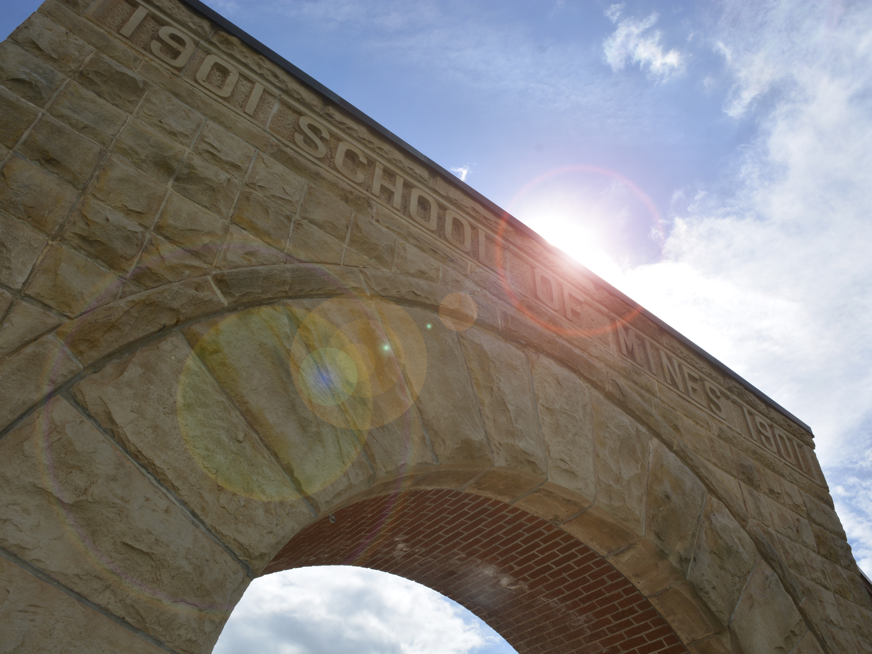


Purchasing – Printing - Clothing
Director of Business Services (Purchasing) – Barb Mustard, Barbara.Mustard@sdsmt.edu
Director of Marketing (Branding) – Ann Brentlinger, Ann.Brentlinger@sdsmt.edu
Director of University Bookstore (Rocker Shop) – Marlin Kinzer, Marlin.Kinzer@sdsmt.edu

Slide 2



Purchasing $ Thresholds
Under $1,000 Purchase:
Supplies/Equipment purchase on a PO if possible
No sales tax on reimbursements
All computers, printing, and clothing must be purchased on a PO
Over $1,000:
PO is required with quote
Over $4,000:
Sealed bid process
State contract items are exempt
Admin. Support person for each department submits POs for students and departments.

Slide 3

Accounts Payable | Invoices and Bills
Have bill or invoice ready to pay
  Actual invoice
  A# on each invoice
  Fix tax if charged
  Account number
  Authorized Signer
Membership Invoices
  No personal memberships
  Be sure term is on invoice
  Memberships greater than $100 need approval from Director of Finance

Slide 4
Accounts Payable | Check Requests
Check Request (Reimbursement):
Explain, Explain, Explain
  WHAT is being purchased
  WHERE is it located on campus
  WHEN did it arrive
  WHO purchased it
  HOW did they purchase it
Fill out check request form completely
Authorized signer must sign the form
Required documentation
  Original receipt
    Bank statement
  List of names (full name)
    Food, clothing, ticketed items
  You cannot be reimbursed until the item is received
  No sales tax reimbursed for supplies/equipment

Slide 5




Logos

Slide 6



Logos You Can Use
University logos
Approved Word Mark

Slide 7






Never embellish or manipulate logos
DO NOT

Slide 8



Logos You Cannot Use
Alumni Association logo
This is the university seal, NOT a logo
Foundation logo
Old Grubby

Slide 9
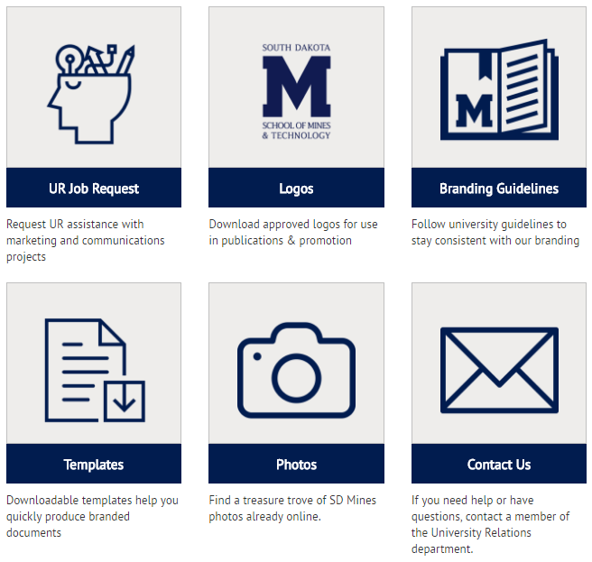
Branded Resources

Slide 10
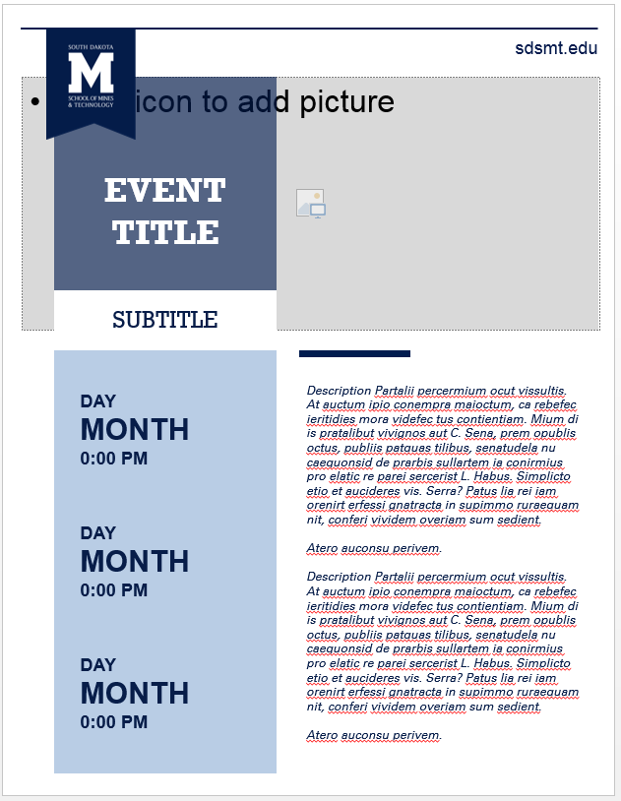

Branded Templates

Slide 11
SD Mines Apparel Licensing
Ordering Apparel for
Campus Groups & Departments

Slide 12
SD Mines Licensing Policy
POLICY (V-B-08 – Sept. 2004)
The University marks are registered with the South Dakota Secretary of State. Licensing for reproduction of all University marks and verbiage on merchandise for resale to faculty, staff, students, and the general public must be approved by the University Bookstore Director or designee.
Approval may not be given for items:
  of poor quality;
  that are not representative of the institution’s mission;
  whose resale does not benefit the institution or a University-recognized entity financially
Resalable items
  Licensing forms required via Bookstore Director
Non-resalable items
  Authorized by Vice President of University and Public Relations

Slide 13
Become Licensed & Current Vendors
How to Become Licensed
  Complete University’s Non-Exclusive Licensing Agreement
    Marlin, Bookstore Director
  Cost
    Initial fee = $100
    Annual renewal = $50
    Art approvals required
    Royalty rate is 10% of net price of goods
  Depending upon the vendor, licensing time frame can vary
Fall 2017 Local Vendors
  Stec’s Advertising Specialties
  JJ’s Engraving
  Dakota Sports
  The Rocker Shop
No online vendors are licensed at this time
  Custom Ink
  Vistaprint
  Etc.

Slide 14
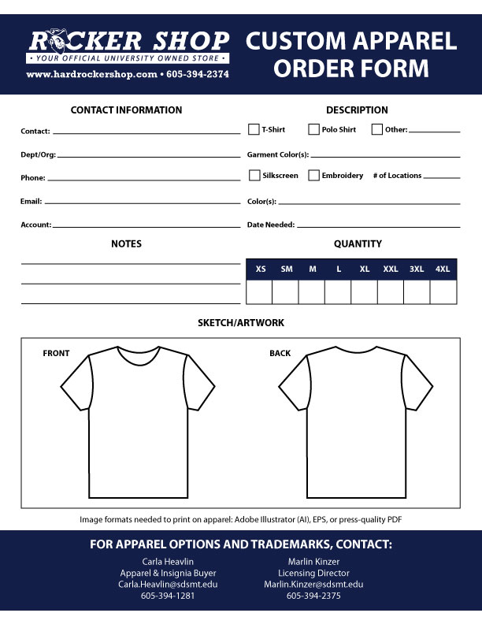
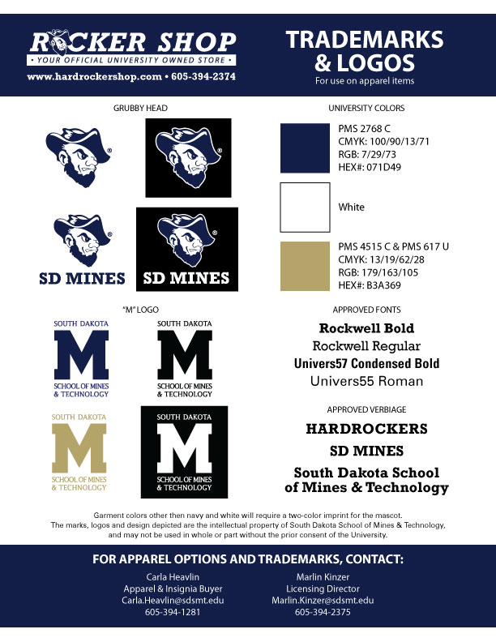
Custom Shirt Order Form
www.hardrockershop.com
Left hand side, select “Resources”
Click “Custom Shirt Orders”
Fill out via Adobe or print
Submit to The Rocker Shop
  Email:
    Carla Heavlin
    Marlin Kinzer

Slide 15



Approved SD Mines Logos & Verbiage
Trademarks
  Licensed marks = federal trademarks
  Cannot be reproduced UNLESS licensed to do so
Verbiage
  “HARDROCKERS”
  “SD MINES”
  “SOUTH DAKOTA MINES”
  “SOUTH DAKOTA SCHOOL OF MINES & TECHNOLOGY
  NO “AND” - MUST BE “&”
UR, Rocker Shop, and approved vendors can help with artwork/graphics

Slide 16
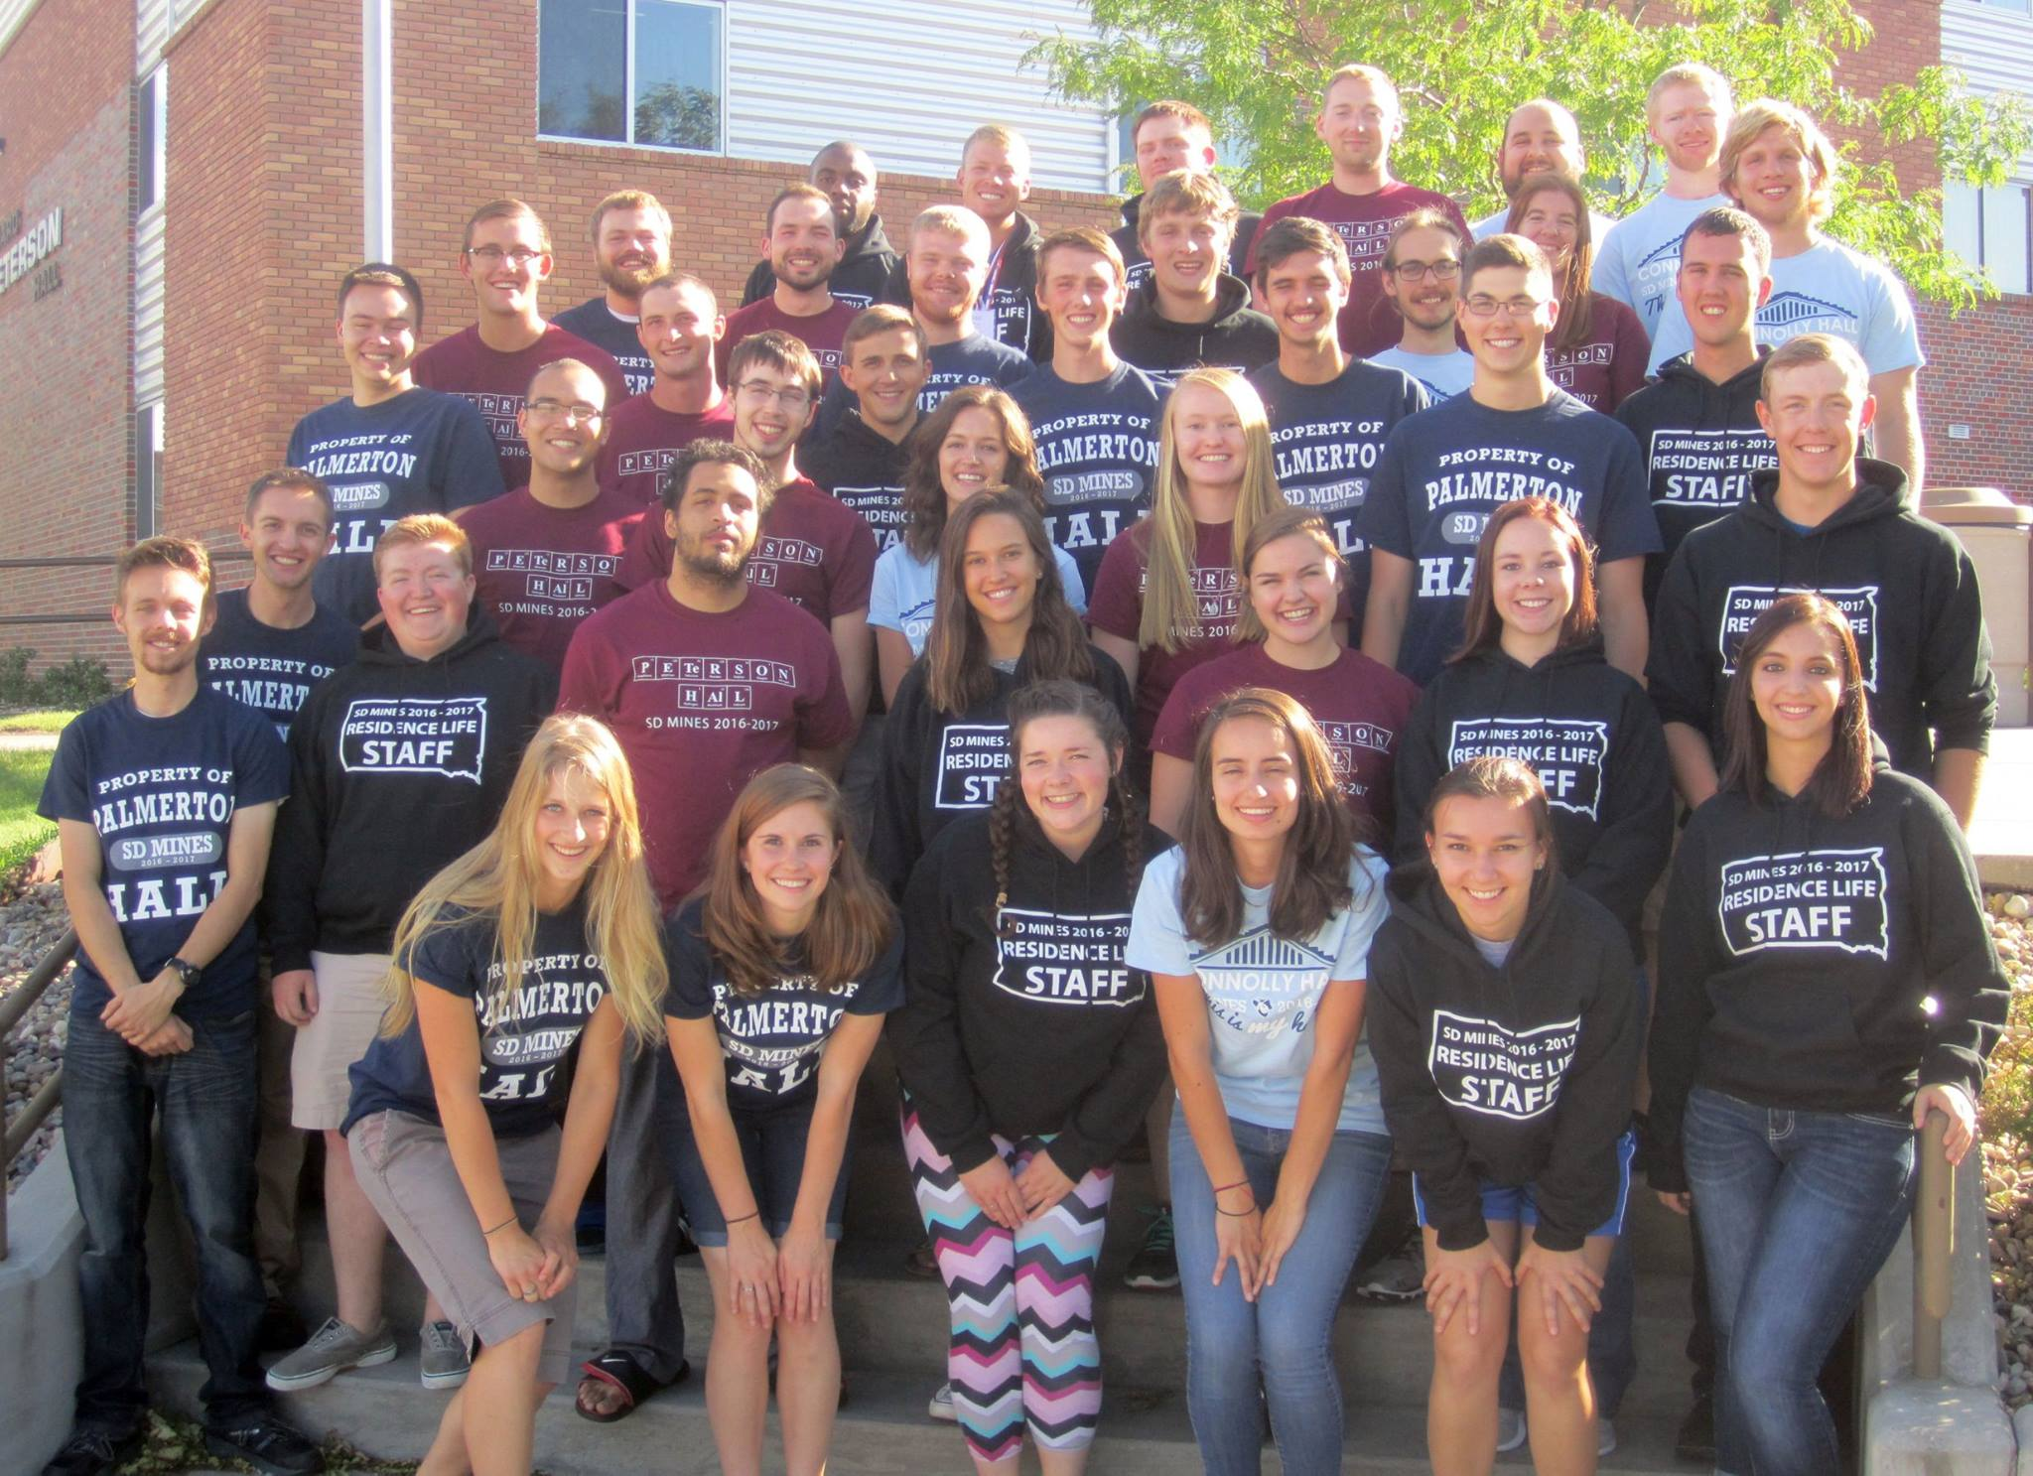
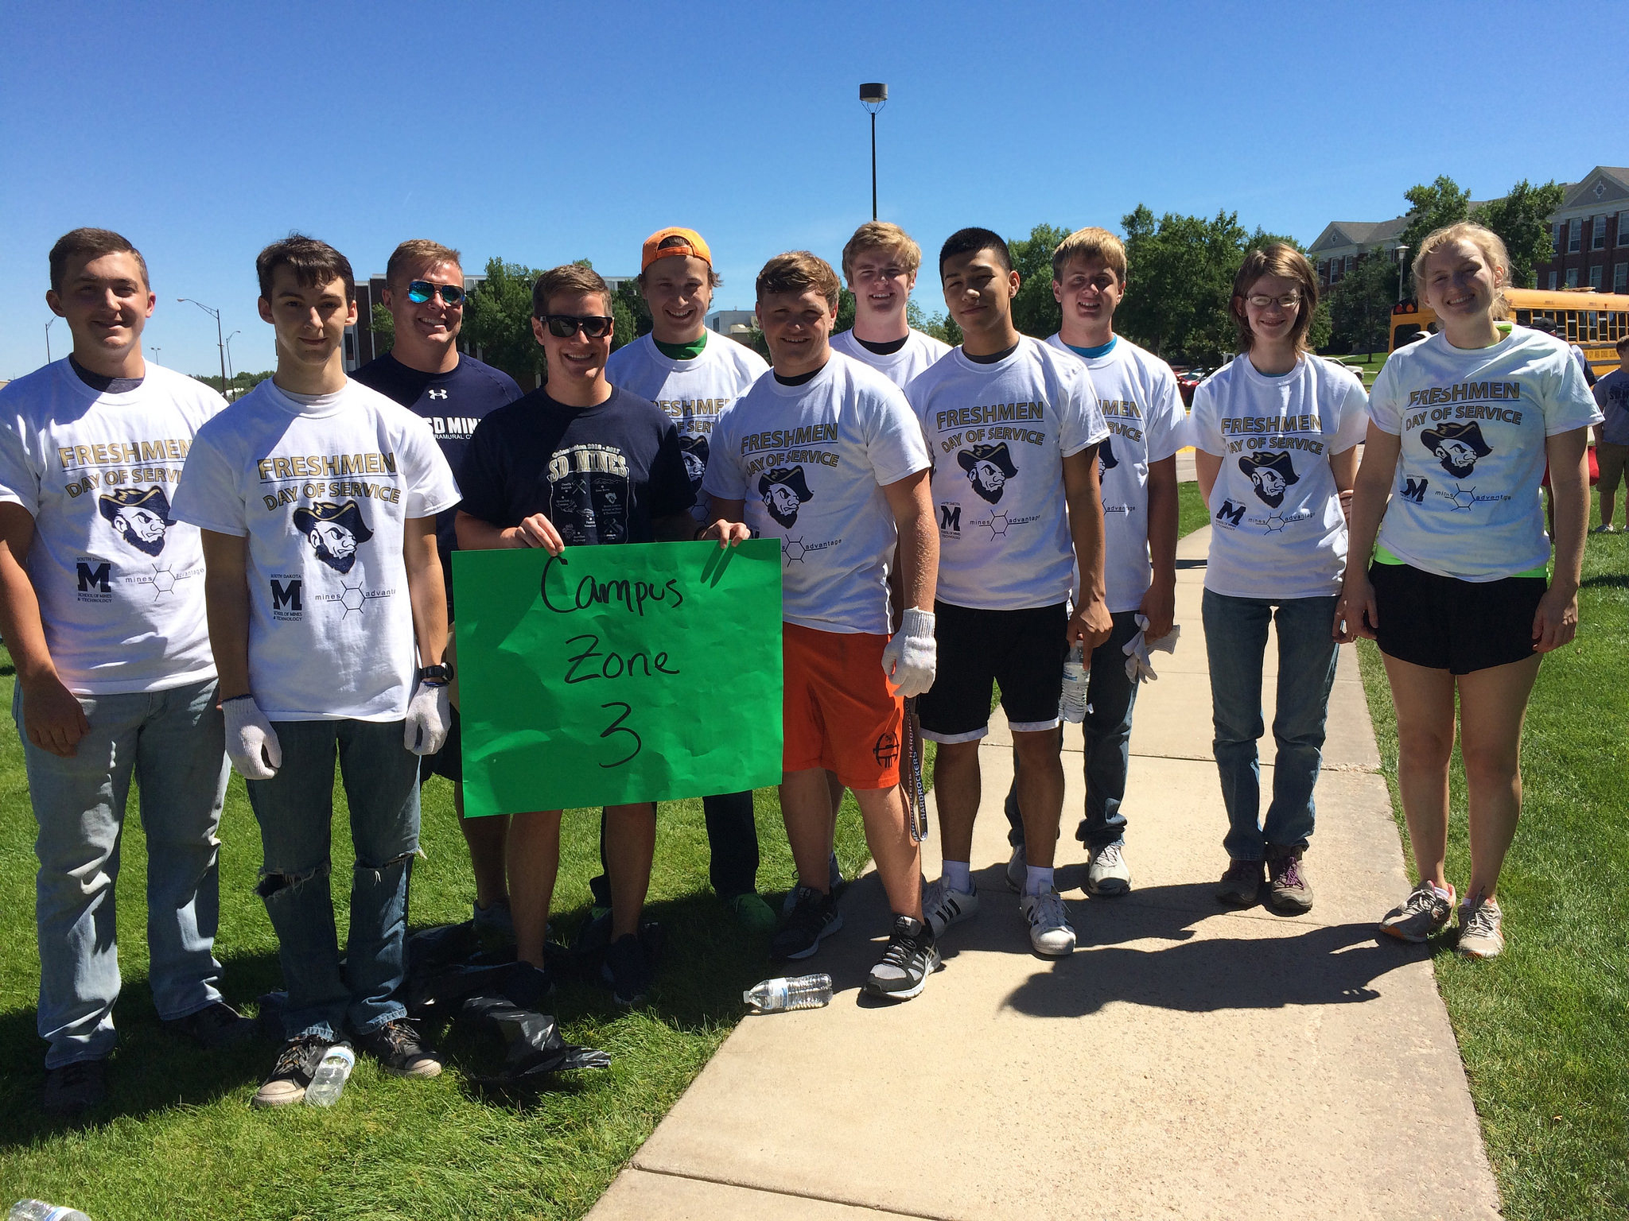
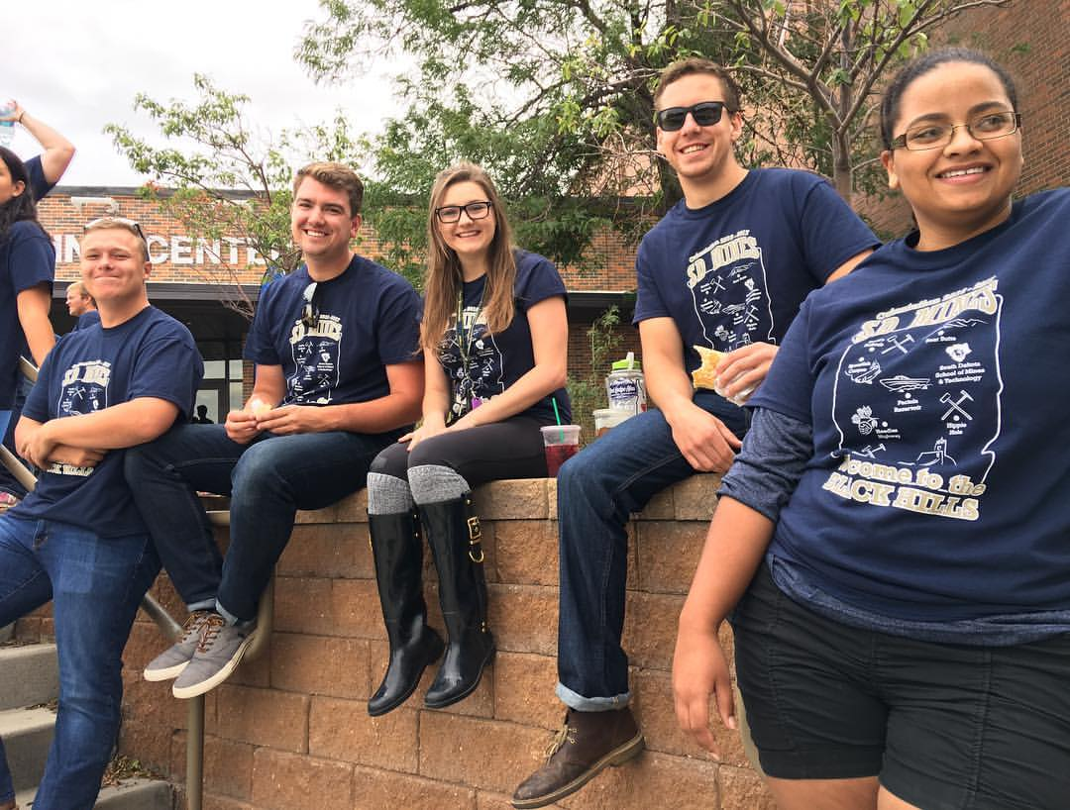
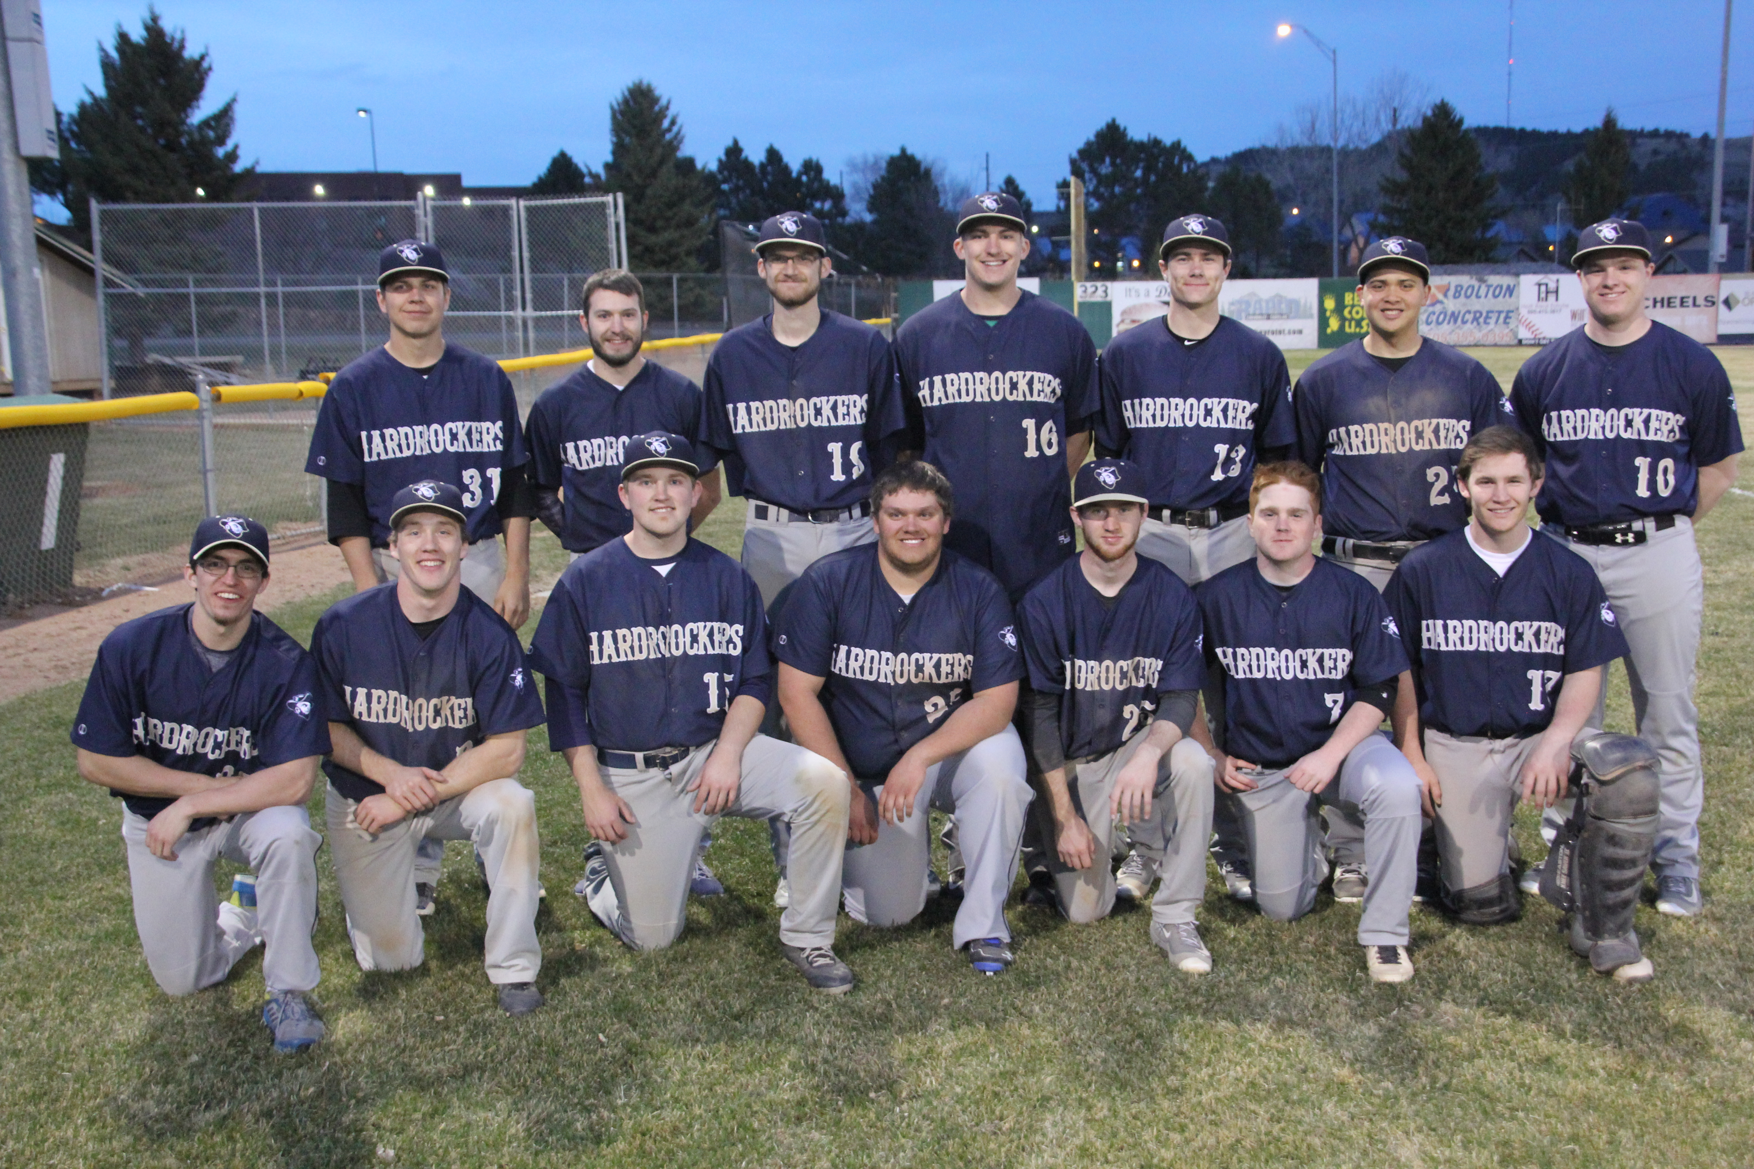
Campus Groups Rocker Shop Has Worked With
Veterans Club
Moon Rockers
Residence Life
Freshman Day of Service
Mines Advantage
PDI
Dean of Students Staff
Student Senate
Hardrocker Club Baseball Team
Circle K
Dublin Dash
Mining and Mucking Team
SD Mines Future Health Science Professionals

Slide 17
REMEMBER:
Plan Ahead
  The more lead time = better service and pricing
Graphic File Types
  Adobe Illustrator (.AI) or .EPS files are required for apparel items
    JPEG/PNG – not print ready for custom apparel
Rocker Shop Offers Competitive Pricing
  Special order apparel is sold at a slim margin – usually 10%-20% over cost
Rocker Shop = On-Campus Convenience
  Campus and Foundation Accounts are easy to use in store
Order Form – visit our site
Rocker Shop staff has over 40 years experience in selling custom apparel
Rocker Shop is Here to Help
  Whether you purchase from Rocker Shop or another licensed vendor, trademark standards need to be followed
Save on Fees
  Partnering with UR and the Rocker Shop can save your group art charges and set up fees

Slide 18
KEEP IT ON CAMPUS!!!
100% of revenue generated by
the Rocker Shop goes back into
South Dakota School of Mines & Technology!

